Slide 1
Global Hydro-Estimator Satellite Rainfall Estimates
Critical Design Review
September 9, 2011
Prepared By: Limin Zhao², Bob Kuligowski¹, Clay Davenport³, and Walter Wolf¹
¹ NOAA/NESDIS/STAR
² NOAA/NESDIS/OSPO
³ SSAI

Slide 2
Review Agenda
Introduction 1:00 pm – 1:20 pm
Risks 1:20 pm – 1:30 pm
Requirements 1:30 pm – 1:50 pm
Operations Concept 1:50 pm – 2:05 pm
Algorithm Theoretical Basis 2:05 pm – 3:05 pm
Break 3:05 pm – 3:15 pm
Software Architecture and Interfaces 3:15 pm – 4:00 pm
Quality Assurance 4:00 pm – 4:15 pm
Risks and Actions 4:15 pm – 4:25 pm
Summary and Conclusions 4:25 pm – 4:30 pm

Slide 3
Outline
Introduction Zhao
Risks Wolf
Requirements Wolf
Operations Concept Zhao
Algorithm Theoretical Basis Kuligowski
Software Architecture &Interfaces Davenport
Quality Assurance Wolf
Risks and Actions Wolf
Summary and Conclusions Zhao

Slide 4
Introduction
Presented by
Limin Zhao

Slide 5
Introduction
Project Background
  Current Operational System
  Current Offline Global System
Project Objectives
Project Stakeholders
Project Plan
Project Risk Management

Slide 6
Background
The H-E has been the operational CONUS algorithm at NESDIS since 2002
The H-E retrieves instantaneous rain rates from IR brightness temperatures (TBs) and uses numerical weather model data to account for subcloud effects
  Fields of PW, RH and 700 hPa winds plus T and q profiles from a numerical model, such as, NCEP Global Forecast System (GFS), and a Digital Elevation Model (DEM) for the orographic modifications
  For each routine scan, IR TBs are read, ancillary data are read and processed, algorithm is applied to the TBs with adjustments based on ancillary data, generated output is converted to several formats, output is sent to server for distribution

Slide 7
Requirements
  1010-0019, “Global Hydro-Estimator Satellite Rainfall Estimates”. Transition global Hydro-Estimator from STAR to OSPO to replace current CONUS Hydro-Estimator.
  1006-0009, “Making Multi-day (more than 24hrs) NESDIS Hydro-Estimator Rain Estimates Operationally” Make 2-7 day HE totals for the CONUS.
  9712-8, “Implement Graphical Auto-Estimator on AWIPS.” The original request for automated satellite products at NESDIS, which led to the Auto-Estimator and Hydro-Estimator over the CONUS.

Slide 8
Background
The Hydro-Estimator has been run in real-time at STAR since 2005.
The CONUS Hydro-Estimator algorithm is applied to data from GOES-E and –W, METEOSAT-7 and -9, and MTSAT-1, using NAM data for the adjustments where available and GFS data elsewhere.
The instantaneous rates are aggregated into 1-h totals, for each sector, and the resulting sectors are then mosaicked into a global 1-h total that is converted to ASCII and served via ftp.
All satellite and model data are obtained from OSPO servers via ADDE.

Slide 9
Background -- Satellites
Satellite and sensor | Longitude | Band | Wavelength Range (μm) | Central Wavelength (μm) | Sub-satellite IGFOV (km) | Scan Frequency
GOES-11 Imager | 135°W | 4 | 10.20-11.20 | 10.7 | 4 | CONUS: 15 min NH: 30 min SH: 30 min or 3 h
GOES-13 Imager | 75°W
METEOSAT-9 SEVIRI | 0°E | 9 | 10.28-11.28 | 10.8 | 3 | FD: 15 min
METEOSAT-7 MVRI | 57.5°E | 3 | 10.5-12.5 | 11.5 | 5 | FD: 30 min
MTSAT-1R Imager | 140°E | IR1 | 10.3-11.3 | 10.8 | 4 | NH: 30 min SH: 60 min

Slide 10
GHE Objectives
Provide global Rainfall Rates within 50 minutes of observation (or 20 minutes of data receipt) to NWS, the Hydrologic Research Center, and NESDIS:
  Rainfall Rates derived from GOES-East , GOES-West, METEOSAT-7, METEOSAT-9, MTSAT-1R
  Product Quality Flags
  Metadata
  Diagnostics
Retire the operational CONUS-only HE and feed NWS CONUS-HE from the global HE

Slide 11
Capabilities & Impacts
The Global Flash Flood Guidance (GFFG) system, which is the result of collaboration among NOAA, the Hydrologic Research Center (HRC), and the WMO, relies on the Hydro-Estimator rainfall estimate to drive the GFFG, which is currently providing real-time flash flood guidance for Central America and the Mekong Delta and will soon provide guidance for southern Africa and the Black Sea region.
The STAR H-E global product meets this need, but with the continual risk of outages at crucial times. This risk can be resolved only by operational implementation of the global H-E at OSPO.

Slide 12
Project Stakeholders –
Customers and Users
Users:
  Dan Beardsley (NWS)
  Liqun Ma (SPB)
  Sheldon Kusselson (SAB)
  Konstantine Georgakakos, Bob Jubach (HRC)

Slide 13
Project Stakeholders – Operations and Maintenance
OSPO Products Area Lead – Limin Zhao
OSPO QA Lead – Zhaohui Cheng
Operational Implementation and Maintenance Team
  Clay Davenport
  William Pennoyer
  Jessica Staude
Science Maintenance Team
  Bob Kuligowski
  Zhihua Zhang

Slide 14
Project Stakeholders – Development Team
STAR (Bob Kuligowski, Clay Davenport, Peter Keehn, Yi Song)

Slide 15
Project Plan
Stakeholder Involvement
Development Team
  Coding and documentation
  Quality assurance
  Data verification and validation
  Configuration Management
Operation and Maintenance
  Code Acceptance
  Running system
  Interface with operations
  Monitoring
  Distribution
Customers and/or Users
  Supply customer request
  Review project development
  Archive data
  Communicate with development team

Slide 16
HE Project:
Organization Chart
Customers/Users
NWS, SPB, SAB, HRC,
STAR,CLASS
HE Project
Limin Zhao (PI)
Bob Kuligowski (Backup)
Research Algorithm
Bob Kuligowski (Lead)
Clay Davenport
(Scientist/Programmer)
Development Team
Bob Kuligowski & Walter Wolf
Operations Team
Limin Zhao (Lead)
Zhaohui Cheng (QA Lead)
Clay Davenport (Ops Development)
William Pennoyer (Ops Primary)
Jessica Staude (Ops Backup)
Pre-Operational Algorithm
Walter Wolf (Lead)
Peter Keehn (Programmer)
Yi Song (Programmer)
Support
Kexin Zhang (QA Lead)
Yunhui Zhao (CM)
Larisa Koval (Documentation)

Slide 17
Project Plan:
Task and Schedules
Tasks:
  Defined in “FY11_Geo_Global_Hydro_Estimator_V4.ppt” (SPSRB PSDI)
Schedule (key milestones):
  Preliminary Design Review – Aug 3, 2011 (Combined with CDR)
  Critical Design Review – Aug 3, 2011 (slides available)
  Software Review – Oct 31, 2011
  System Readiness Review – Jan 2012 (TBR)
  SPSRB Briefing – Feb 2012
  Operations Commence – Mar 2012

Slide 18
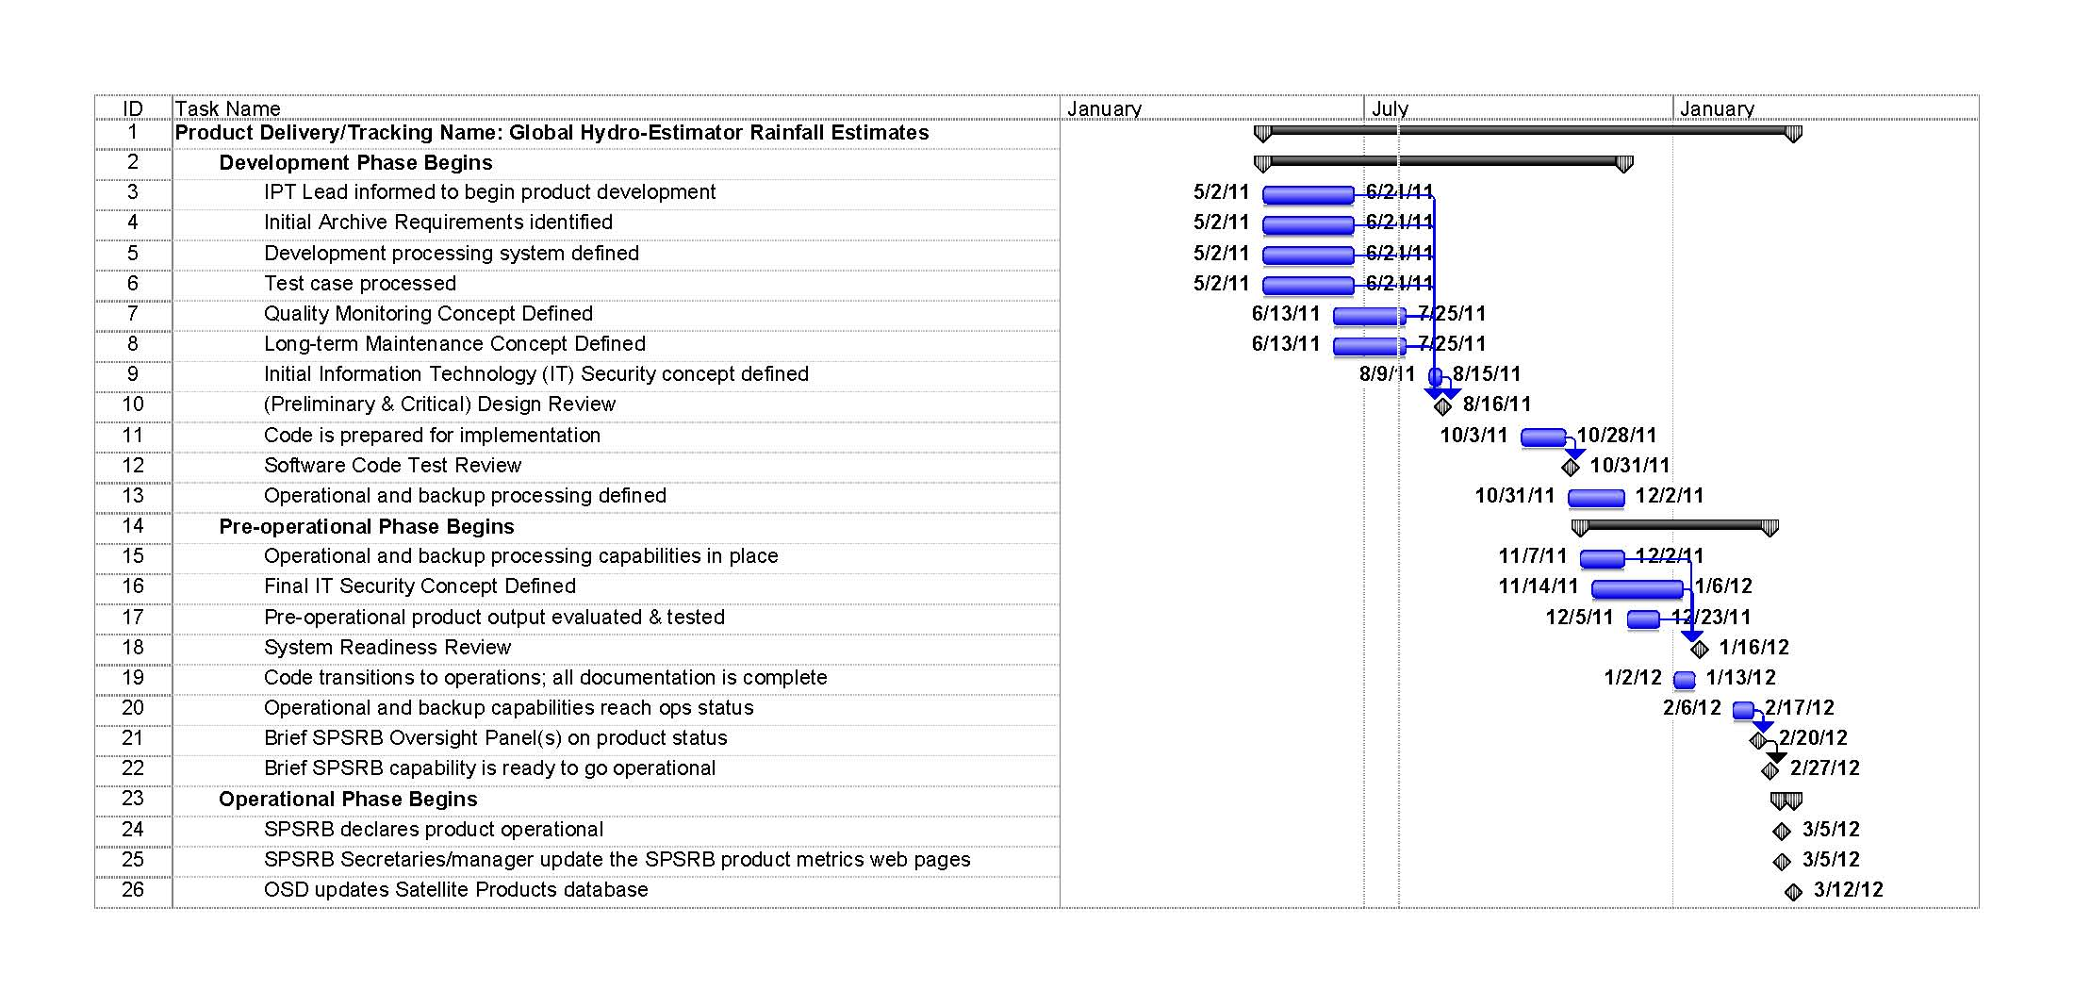
GHE Project Timeline:
Algorithm Development
PDR Waived
CDR 08/16/11
SRR 01/16/12
Notes:
Need to Update

Slide 19
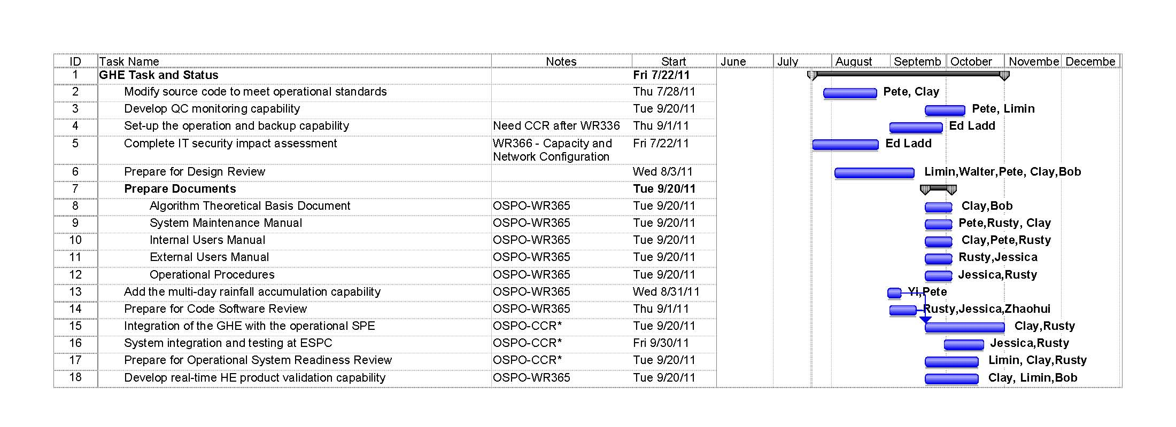
GHE Project Timeline:
Compressed Algorithm Development

Slide 20
GHE Project
Risk Management
Risk Management Process:
  Identify
  Analyze
  Plan
  Track
  Control
Risk Reduction:
  GOES Heritage System
  Offline Global System
  Communication
  Documentation
Project risks will be identified in the “risks” section and risk mitigation plans and actions will also be addressed.

Slide 21
GHE CDR –
Entry Criteria
Risks and Actions
Review of Global GHE CDR
  Operations Concept
  Requirements
  Algorithm Theoretical Basis
  Software Architecture and Interfaces
  Quality Assurance
  New Risks and Actions

Slide 22
GHE Team CDR –
Exit Criteria
Critical Design Review Report
  The CDR Report (CDRR), a standard artifact of the STAR Enterprise Process Lifecycle (EPL), will be compiled after the CDR
  The report will contain:
    Actions
    Comments
    CDR presentation

Slide 23
Review Objectives
Review the project plan
Review the operations concept
Review the requirements
Review the algorithm theoretical basis
Review the software system architecture and interfaces
Review the plans for quality assurance
Review the requirements allocation
Review risks and actions

Slide 24
Review Agenda
Introduction Zhao
Risks Wolf
Requirements Wolf
Operations Concept Zhao
Algorithm Theoretical Basis Kuligowski
Software Architecture and Interfaces Davenport
Quality Assurance Wolf
Risks and Actions Wolf
Summary and Conclusions Zhao

Slide 25
CDR Review Report
and Actions
Presented by
Walter Wolf

Slide 26
GHE Pre-CDR
Reports and Actions
Open Pre-CDR Risks and Actions

Slide 27
Pre-CDR Risks and Actions

Slide 28
Pre-CDR Risks and
Actions For GHE
Pre-CDR Risk 1: PDR was waived. Going straight to CDR.
Risk Assessment: Medium
Impact: If the overall project information is not provided at the CDR then the project will fall behind schedule increasing costs
Likelihood: Medium
Mitigation:
  Identify the project tasks and address them within the CDR
Status: Closed

Slide 29
Pre-CDR Risks and
Actions For HE
Pre-CDR Risk 2: Possible loss of Meteosat data
Risk Assessment: Low
Impact: If Meteosat data is lost, then there will not be complete global coverage for the GHE rainfall products
Likelihood: Low
Mitigation:
  Work with NESDIS managements to ensure that Meteosat data is readily available
Status: Open

Slide 30
Pre-CDR Risks and
Actions For GHE
Pre-CDR Risk 3: Compressed schedule due to funding needing to be spent by 09/30/11
Risk Assessment: Medium
Impact: If the tasks are not completed, then the system will not be transitioned to operations
Likelihood: High
Mitigation:
  Add more staff on the STAR and OSPO side to complete the transition tasks before 09/30/11
Status: Open
Notes:
Slide 30 - Bolded Mitigation & Status text to make all slides match

Slide 31
Pre-CDR Risks and
Actions For GHE
Pre-CDR Risk 4: Uncertainty in availability of any funds unspent by 09/30/11
Risk Assessment: Medium
Impact: Project may not be completed if not all funds are available
Likelihood: High
Mitigation:
  Work with NWS to extend leftover funding into FY12
Status: Open

Slide 32
Outline
Introduction Zhao
Risks Wolf
Requirements Wolf
Operations Concept Zhao
Algorithm Theoretical Basis Kuligowski
Software Architecture &Interfaces Davenport
Quality Assurance Wolf
Risks and Actions Wolf
Summary and Conclusions Zhao

Slide 33
Global Hydro-Estimator Requirements
Presented by
Walter Wolf

Slide 34
GHE -
Requirements
Product name | Geographic Coverage | Horizontal Resolution | Mapping Uncertainty | Measurement Range | Measurement Precision | Measurement Accuracy | Latency | Refresh Rate
Instantaneous rainfall rate , 1-hour, 3-hour, 6-hour, 24-hour and multi-day rainfall accumulations | Global from 60°S to 60°N | 4 km | 4 km | 0 ~ 76 mm/h | 6 mm/h at rates of 10 mm/h, with higher values at higher rates | 6 mm/h at rates of 10 mm/h, with higher values at higher rates | 20 min | 20 min

Slide 35
Project Requirements
Have Been Established
Established for Critical Design Review (CDR)
  Critical Design Review Report (CDRR – this presentation)
  Requirements Allocation Document (RAD) v1r0

Slide 36
Requirements Allocation
Document
Requirements Allocation Document (RAD) v1r0
  RAD v1r0 is a CDR artifact.
  Contains the basic and derived requirements for the work products
  Contains the allocation of the requirements to system components and product components

Slide 37
GHE Requirements –
Basic Requirement 0.0
Basic Requirement 0.0 - The GHE project shall adopt the standard practices of the STAR Enterprise Product Lifecycle (EPL), as established in the STAR EPL process assets v2.0. (process)

Slide 38
GHE Requirements –
Basic Requirement 1.0
Basic Requirement 1.0: Integrated Product Team (IPT) shall generate real-time estimates of rainfall at the full IR pixel scale for the entire globe. (product, functional)
User request: (1010-0019, “Global Hydro-Estimator Satellite Rainfall Estimates”).
  Derived Requirement 1.1:The Global Hydro-Estimator algorithm shall be applied to data from GOES-11 and GOES–13, METEOSAT-7 and -9, and MTSAT-1R geosynchronous satellites, using GFS model data for the adjustments for the effects of moisture availability, evaporation, orographic modulation, and thermodynamic profile effects.

Slide 39
GHE Requirements –
Basic Requirement 1.0
  Derived Requirement 1.1: The Global Hydro-Estimator algorithm shall be applied to data from GOES-11 and GOES–13, METEOSAT-7 and -9, and MTSAT-1R geosynchronous satellites, using GFS model data for the adjustments for the effects of moisture availability, evaporation, orographic modulation, and thermodynamic profile effects.
  Derived Requirement 1.1.1:All satellite and model data shall be obtained from OSPO servers via ADDE.

Slide 40
GHE Requirements –
Basic Requirement 2.0
Basic Requirement 2.0:The rainfall products shall include: (1) instantaneous rainfall rate and 1-hour rain rate over global; (2)1-hour, 3-hour, and 6-hour rainfall estimate, daily rainfall estimate, 2-day rainfall estimate, 3-day rainfall estimate, 4-day rainfall estimate, 5-day rainfall estimate, 6-day rainfall estimate and 7-day rainfall estimate over CONUS.
User requests: (1010-0019, “Global Hydro-Estimator Satellite Rainfall Estimates”; 1006-0009, “Making Multiday (more than 24hrs) NESDIS Hydro-Estimator Rain Estimated Operationally”).

Slide 41
GHE Requirements –
Basic Requirement 3.0
Basic Requirement 3.0: Global Rainfall Rates shall be generated and distributed within 50 minutes of observation (or 20 minutes of data receipt) to NWS, the Hydrologic Research Center, and NESDIS users. (product)

Slide 42
GHE Requirements –
Basic Requirement 4.0
Basic Requirement 4.0: The rainfall products shall be in netCDF4/McIDAS formats.

Slide 43
GHE Requirements –
Basic Requirement 5.0
Basic Requirement 5.0: The rainfall products retrieval quality shall be indicated with a set of quality control flags.

Slide 44
GHE Requirements –
Basic Requirement 6.0
Basic Requirement 6.0: The Integrated Product Team shall define Metadata for each rainfall product.

Slide 45
GHE Requirements –
Basic Requirement 7.0
Basic Requirement 7.0: The Integrated Product Team shall perform validation and verification of the GHE products.
  Derived Requirement 7.1: GHE products shall be validated by comparing retrieved instantaneous rainfall rates with Tropical Rainfall Measuring Mission (TRMM) spaceborne Precipitation Radar (PR) between 35ºS and 35ºN.
  Derived Requirement 7.2: The IPT shall verify that the GHE products in the output files are generated correctly and documented.

Slide 46
GHE Requirements –
Basic Requirement 8.0
Basic Requirement 8.0:The GHE software shall be delivered to the OSPO team for testing and operational implementation.

Slide 47
GHE Requirements –
Basic Requirement 9.0
Basic Requirement 9.0:The global Hydro-Estimator Rainfall products (netCDF4) and corresponding metadata shall be archived at NCDC/CLASS (TBD)
  Derived Requirement 9.1: Distribution of the Archive Products to NCDC/CLASS shall be in accordance with a Data Submission Agreement (DSA).

Slide 48
GHE Requirements –
Basic Requirement 10.0
Basic Requirement 10.0: The GHE shall maintain heritage with operational CONUS Hydro-Estimator and ensure continuity /consistency.
  Derived Requirement 10.1: The global Hydro-Estimator shall be integrated the current operational HE-SPE, and take it as its sub-system.
  Derived Requirement 10.2: The global Hydro-Estimator shall have the capability to provide hourly rainfall estimate in GRIB format to NWS.

Slide 49
GHE Requirements –
Summary
The Global Hydro-Estimator Requirements have been established.
The Global Hydro-Estimator Requirements have been documented in the Requirements Allocation Document (RAD).
The Global Hydro-Estimator Requirements are traceable to drivers (customer needs or expectations) and other requirements.

Slide 50
Outline
Introduction Zhao
Risks Wolf
Requirements Wolf
Operations Concept Zhao
Algorithm Theoretical Basis Kuligowski
Software Architecture &Interfaces Davenport
Quality Assurance Wolf
Risks and Actions Wolf
Summary and Conclusions Zhao

Slide 51
Operations Concept
Presented by
Limin Zhao
NOAA/NESDIS/OSPO

Slide 52
Operations Concept - Overview
Identify intentions of the customers/users of the products
  Review the concept of operations that the customers/users has documented in the SPSRB user request
  Interact with customers/users to produce an initial algorithm theoretical basis that is consistent with their concept of operations
Review the answers to the following questions based on customer/user needs and expectations and production constraints
  What is the product?
  Why is this product being produced?
  How will this product be used?
  How should this product be produced (operational scenario)?
The operations concept will be refined by the GHE IPT, in consultation with customers/users, as the product solution and design are matured through the design development phase.

Slide 53
GHE Rainfall Products Customers
GHE requirements originate from NWS through the SPSRB user request
  Customers
  General product types
  More specific product specifications will require an interactive dialog with the customers when identified.
The U.S. customers are identified as the only requirements driver for products in the global Hydro-Estimator Rainfall Products Requirement Allocation.
  NWS
  Hydrological Research Center (HRC)
  NESDIS/SAB
  NCDC/CLASS
Potential International Customers
  China Meteorological Administration (CMA)

Slide 54
What is the Product?
The global Hydro-Estimator rainfall estimate utilizes IR brightness temperatures to identify regions of rainfall and retrieve rainfall rate, then uses GFS model fields to adjust the rainfall rate for the effects of moisture availability, evaporation, orographic modulation, and thermodynamic profile effects.
The rainfall products include:
  Global: instantaneous rainfall rate and 1-hour rainfall rate
  CONUS: instantaneous rainfall rate and 1-hour, 3-hour, and 6-hour rainfall estimate, daily rainfall, 2-day, 3-day, 4-day, 5-day, 6-day and 7-day rainfall estimate.
  The products will also include observation time, data quality flags, and other metadata information.
Parameters | Specifications
Environmental parameter | Instantaneous rainfall rate , 1-hour, 3-hour, 6-hour, 24-hour and multi-day rainfall accumulations
Geographical Coverage | Global from 60°S to 60°N
Horizontal Resolution/grid spacing | 4 km
Mapping Uncertainty | 4 km
Measurement Range | 0 ~ 76 mm/h
Measurement Precision | 9 mm/h at rates of 10 mm/h, with higher values at higher rates
Measurement Accuracy | 6 mm/h at rates of 10 mm/h, with higher values at higher rates
Latency | 20 mins
Refresh | 20 mins

Slide 55
Why Are The Products Being Produced?
  Current operational HE products cover only over CONUS and surrounding waters
  Users need the operational capability for Hydro-Estimator rainfall estimate over the entire globe equator-ward of 60 degrees
  The products are now only available from research and support under the best effort at STAR, so users is under consistent threat of outages (potentially at critical times) not being addressed in a timely fashion.

Slide 56
How Will The Products Be Used?
The global HE products are currently used for supporting the OCONUS flash flood forecasting operations (GFFG – Global Flash Flood Guidance)
HRC users will switch the data access from STAR to OSPO after the products are made operational available

Slide 57
How Should The Products Be Produced? (1/6)
Satellite Data for Product Generation
  GOES-W&-E GWR (McIDAS AREA)
  Meteosat-7 & -9 (McIDAS AREA)
  MTSAT-1 (McIDAS AREA)
Ancillary Data for Product Generation
  NCEP GFS Model data (GRIB2 converted to McIDAS)
  Global Terrain Maps (McIDAS Area)
  Lookup Tables for Viewing Angle Corrections (McIDAS Area)
Ancillary Data for Product Validation
  Radar (netCDF)
  CPC Daily Rainfall from gauge (GRIB2)

Slide 58
How Should The Products Be Produced? (2/6)
There will be three distinct environments
  Development Environment (STAR and OSPO)
    Development and testing of pre-operational codes on Redhat Linux OS
  Test environment (ESPC)
    Pre-operational code (DAP) received from STAR will be tested on the designated Red Hat Linux machine at ESPC and modified as needed before it is promoted to operation
  Operation Environment (ESPC)
    Operational DAP will be run to generate the products on the designated Redhat Linux machine at ESPC and the products will be distributed to user through ESPC distribution system (DDS)

Slide 59
How Should The Products Be Produced? (3/6)
Operational Global HE Products
  Coverage
    Global (60S – 60 N)
  Formats
    netCDF4
    McIDAS AREA
  Latency
    20 mins
  Products
    Instantaneous rain rate, 1-hour, 3-hour, 6-hour, 24-hour rainfall accumulation, and multi-day rainfall accumulations

Slide 60
How Should The Products Be Produced? (4/6)
Production and Delivery Scenarios
  The ESPC Ingest Systems will handle all input satellite data and ancillary data
  The global HE product system will collect the satellite inputs and required ancillary data to run the HE algorithm
  The product will be generated in McIDAS AREA and converted into netCDF4 for archive purpose
  The product users will be granted access to the ESPC distribution system through the data access request submission process.
  ESPC will handle the distribution of the global and CONUS HE products

Slide 61
How Should The Products Be Produced? (5/6)
Production Monitoring and Maintenance Scenarios
  The product process will be monitored by ESPC and email alerts will be generated when an error occurs
  The global HE algorithm will provide overall quality control flags and quality summary level information
  ESPC will cover the monitoring of input data latency, product latency, and product distribution
  Offline Statistic comparison with radar and gauge data will be generated for product quality validation
  The Precipitation PAL and maintenance personnel at OSPO will monitor the product quality and will coordinate with the STAR scientists for any product quality issues

Slide 62
How Should The Products Be Produced? (6/6)
Production Archival Scenarios
  Current, no formal archive requirement is identified in the user request for global HE product
  The CONUS HE is archived at NCAR, and will eventually need be transitioned into NCDC.
  The IPT will take initiative to discuss with users and CLASS for the possibility of archiving the HE products with NCDC/CLASS
    The global Hydro-Estimator rainfall product (netCDF4) and corresponding metadata can be archived at NCDC/CLASS
    The product and metadata can be delivered to NCDC/CLASS by ESPC distribution system
    Distribution of the Archive Product to NCDC/CLASS can be in accordance with a Data Submission Agreement (DSA)
    A Request to Archive global Hydro-Estimator Rainfall product can be submitted to NCDC/CLASS

Slide 63
CDR
Risks and Actions
CDR Risk 1: Lack of capability for product quality statistic and trend monitoring of the GHE algorithm -- not fully scoped in the current project plan
Risk Assessment: Moderate
Impact: The GHE algorithm will not have a full scale monitoring capability that is newly proposed by OSPO
Likelihood: Moderate
Mitigation:
  Work with Zhaohui Cheng & Walter Wolf to leverage the tools to be developed under the Product Monitoring PSDI project
Status: Open

Slide 64
Risks and Actions
CDR Risk 2: No archive requirement is identified in the SPSRB user request.
Risk Assessment: Moderate
Impact: The GHE products will not be archived at the time the product is scheduled to go operational
Likelihood: High
Mitigation:
  Finalize with the users’ for their archive need
  Work with NCDC/CLASS to identify the archive funding requirements
  Work with OSD and/or NWS to see if there is any funding available for archive.
Status: Open

Slide 65
Outline
Introduction Zhao
Risks Wolf
Requirements Wolf
Operations Concept Zhao
Algorithm Theoretical Basis Kuligowski
Software Architecture &Interfaces Davenport
Quality Assurance Wolf
Risks and Actions Wolf
Summary and Conclusions Zhao

Slide 66
Hydro-Estimator (H-E) Algorithm Theoretical Basis
Presented by
Bob Kuligowski
66
Notes:
66

Slide 67
H-E Algorithm Theoretical
Basis Outline
Introduction
Observing System Overview
  Product Generated
  Instrument Characteristics
Algorithm Description
  Algorithm Overview
  Processing Outline
  Algorithm Input
  Theoretical Description
Test Data Sets and Outputs
  Simulated/Proxy Input Data Sets
  Output from Simulated/Proxy Data Sets
  Error Budget
67
Notes:
67

Slide 68
H-E Algorithm Theoretical
Basis Outline
Practical Considerations
  Numerical Computation Considerations
  Programming and Procedural Considerations
  Quality Assessment and Diagnosis
  Exception Handling
  Algorithm Validation
Assumptions and Limitations
  Performance
  Assumed Sensor Performance
  Pre-Planned Improvements
References
68
Notes:
68

Slide 69
Global H-E
Algorithm Theoretical Basis
69
69
69
69
Purpose: Provide a physical and mathematical description of the Global Hydro-Estimator algorithm for product developers, reviewers and users.
Documented in the Hydro-Estimator Algorithm Theoretical Basis Document (ATBD)
Notes:
69
69
69
69

Slide 70
H-E Algorithm Background
The Hydro-Estimator has been the operational NESDIS rainfall rate algorithm for the CONUS since 2002.
Modified from the operational Auto-Estimator algorithm, which in turn was an automation of the Interactive Flash Flood Analyzer (IFFA) developed in the 1970s and 1980s
Has run in real-time at STAR since 2005—implementation at OSPO would simply involve code transfer and updating to meet new SPSRB code and documentation standards.
70
70
70
70
Notes:
70
70
70
70

Slide 71
Global H-E
Algorithm Objectives
Provide real-time estimates of rainfall at the full IR pixel scale for the entire globe
Maintain heritage with operational CONUS Hydro-Estimator and ensure continuity / consistency
71
71
71
71
Notes:
71
71
71
71

Slide 72
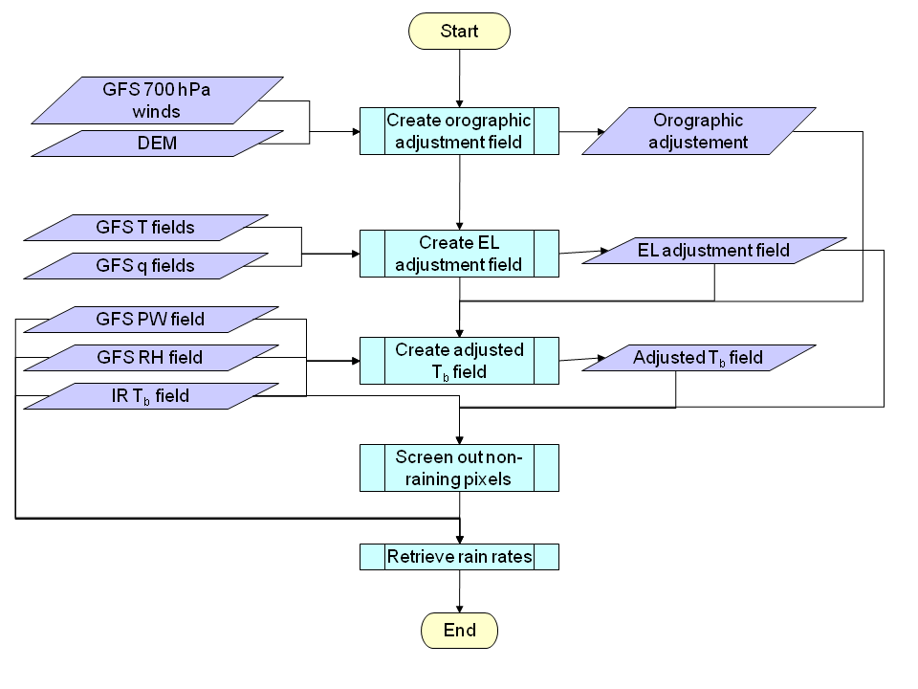
H-E Algorithm
Processing Outline
72
72
Notes:
72
72

Slide 73
H-E Algorithm Sensor Input
Satellite and sensor | Longitude | Band | Wavelength Range (μm) | Central Wavelength (μm) | Sub-satellite IGFOV (km) | Scan Frequency
GOES-11 Imager | 135°W | 4 | 10.20-11.20 | 10.7 | 4 | CONUS: 15 min NH: 30 min SH: 30 min or 3 h
GOES-13 Imager | 75°W
METEOSAT-9 SEVIRI | 0°E | 9 | 10.28-11.28 | 10.8 | 3 | FD: 15 min
METEOSAT-7 MVRI | 57.5°E | 3 | 10.5-12.5 | 11.5 | 5 | FD: 30 min
MTSAT-1R Imager | 140°E | IR1 | 10.3-11.3 | 10.8 | 4 | NH: 30 min SH: 60 min
73
73
73
73
Notes:
73
73
73
73

Slide 74
H-E Algorithm Sensor Input Details
For each block
  Calibrated/Navigated imager brightness temperatures
  Solar-view geometry (satellite zenith and azimuth angles)
Name | Type | Description | Dimension
Longwave IR window brightness temperature | input | Calibrated level 1b brightness temperature at particular sensor’s IR window | grid (xsize, ysize)
Latitude | input | Latitude | grid (xsize, ysize)
Longitude | input | Longitude | grid (xsize, ysize)
View geometry | input | ABI view zenith and azimuth angles | grid (xsize, ysize)
74
74
74
74
Notes:
74
74
74
74

Slide 75
H-E Algorithm Ancillary Input
Ancillary data needed:
  Satellite-specific Dynamic Data: None.
  Non-Satellite Dynamic Data (from GFS forecasts):
    Gridded vertical profiles of temperature and water vapor
    Gridded total precipitable water
    Gridded 700-hPa u and v components
  Satellite-specific Static Data: None.
  Non-Satellite Static Data: Global digital elevation model.
75
75
75
75
Notes:
75
75
75
75

Slide 76
H-E Algorithm Ancillary Input Details
Non-satellite Dynamic Data from GFS Forecasts:
Name | Type | Description | Dimension
Gridded vertical profiles of temperature and water vapor | Input | Gridded vertical profiles of temperature and water vapor | grid (xsize, ysize,zsize)
Gridded total precipitable water | Input | Gridded column total precipitable water | grid (xsize, ysize)
Gridded 700-hPa u and v wind components | Input | Zonal and meridional components of wind at 700 hPa | grid (xsize, ysize)
76
76
76
76
Notes:
76
76
76
76

Slide 77
H-EAlgorithm Ancillary Input Details
Non-satellite Static Data:
Name | Type | Description | Dimension
Digital elevation model | Input | Pixel elevation for the entire globe on a 4-km grid | grid (xsize, ysize,zsize)
77
77
77
77
Notes:
77
77
77
77

Slide 78
Hydro-Estimator Algorithm
Output
Metadata
  Processing date stamp & others
Scientific Datasets
Name | Type | Description | Dimension
Rainfall Rate | Output | Gridded rainfall rate in mm/h | grid (xsize, ysize)
Quality flag | Output | Rain rate quality flag (0—good; ≠0—bad) | grid (xsize, ysize)
78
78
78
78
Notes:
78
78
78
78

Slide 79
Hydro-Estimator Retrieval Strategy
Screen out non-raining pixels
  Adjust pixel temperature based on orography and moisture
  No rain if adjusted temperature > 235 K
  No rain if adjusted temperature > local average
Determine rain rates for raining pixels
  Compute “core” and “non-core” rain rates
  Compute rain rate based on proportion of “core” and “non-core” rain rates based on local brightness temperature
79
79
79
79
Notes:
79
79
79
79

Slide 80
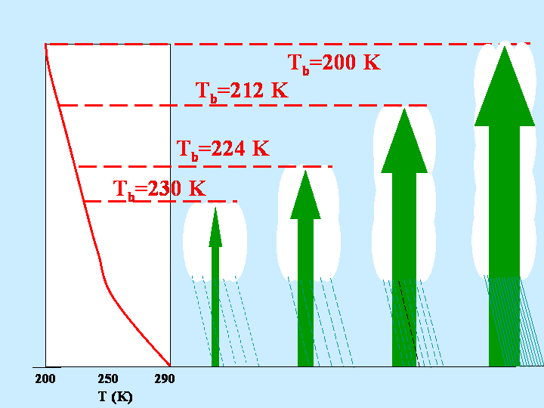
H-E Algorithm: Physical Basis (1)
IR data give cloud-top properties only (e.g., temperature, particle size and phase) because clouds are generally opaque in the IR.
IR rain rates assume that colder clouds have stronger updrafts (vertical transport of moisture) and thus higher rain rates.
80
80
80
80
Notes:
80
80
80
80

Slide 81
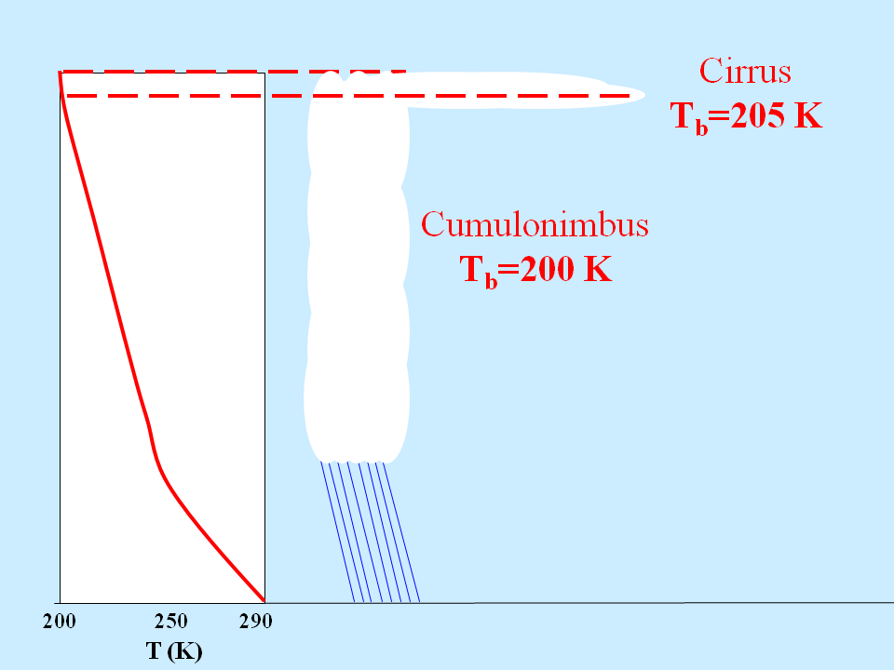
H-E Algorithm: Physical Basis (2)
A significant problem is incorrect identification of cold cirrus clouds as raining.
This results in significant overestimation of the extent of heavy rainfall in many IR-based algorithms.
81
81
81
81
Notes:
81
81
81
81

Slide 82
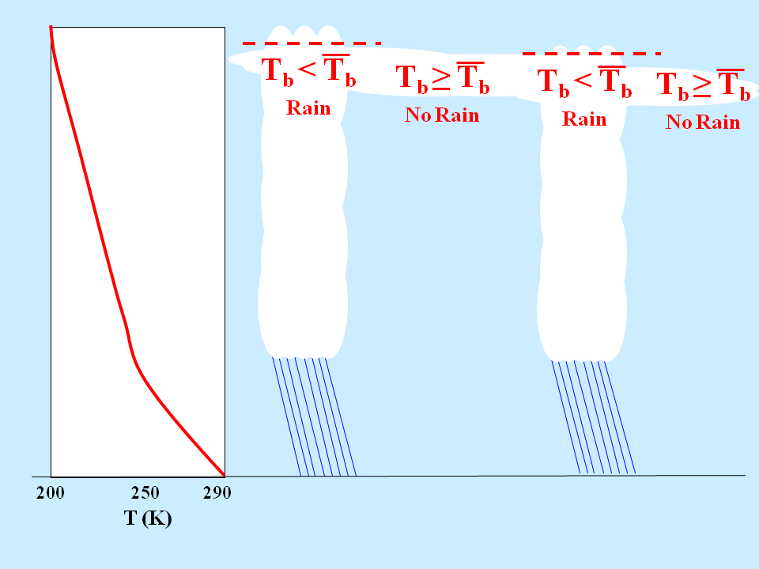
H-E Algorithm: Physical Basis (3)
The H-E addresses this by considering how the cloud-top brightness temperature compares with nearby cloudy pixels:
  Colder than nearby pixels → active updraft with rainfall
  Warmer than nearby pixels → inactive cloud with no rainfall
82
82
82
82
Notes:
82
82
82
82

Slide 83
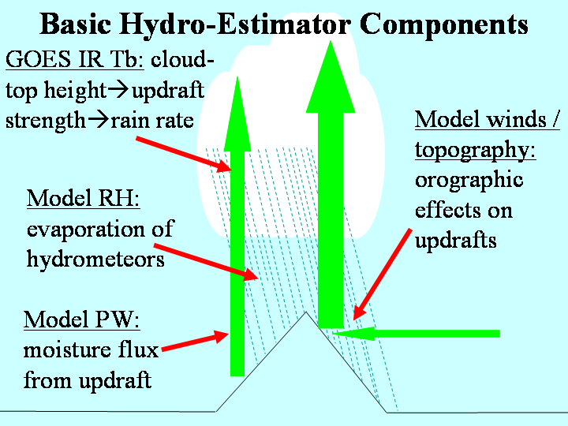
H-E Algorithm: Physical Basis (4)
The H-E also incorporates information from numerical weather models to account for sub-cloud effects, as shown here.
In addition, convective equilibrium level temperature is used to identify regions where strong updrafts and heavy rain can occur even if the thermodynamic profile does not support very cold clouds.
83
83
83
83
Notes:
83
83
83
83

Slide 84
H-E Algorithm Mathematical Description
Algorithm implementation steps:
Perform initial adjustment of IR brightness temperatures based on moisture availability and orographic effects
Determine raining areas
Compute rain rates
84
84
Notes:
84
84
84
84

Slide 85
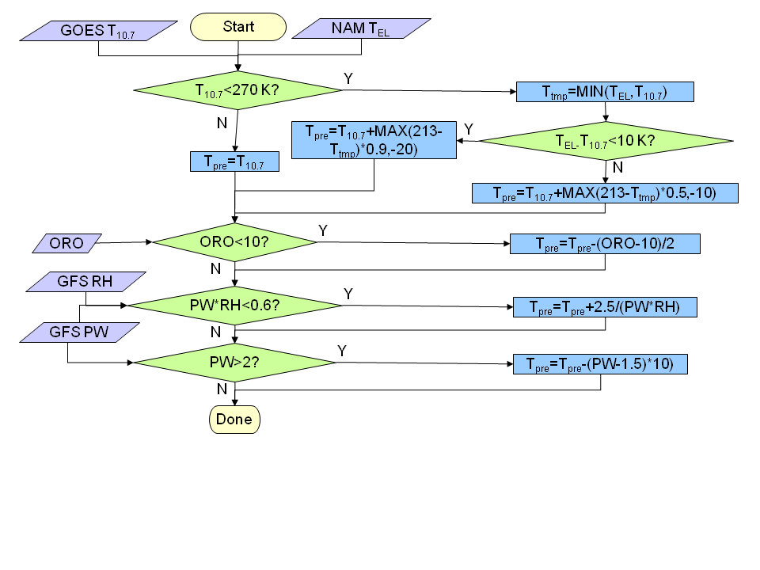
H-E Mathematical Description: IR Tb Adjustment (Overview)
Adjust the initial Tb values for convective equilibrium level, orographic effects, and moisture effects.
Tb’s are adjusted instead of rain rates to allow the addition of new rain areas.
Notes:
85
85
85
85

Slide 86
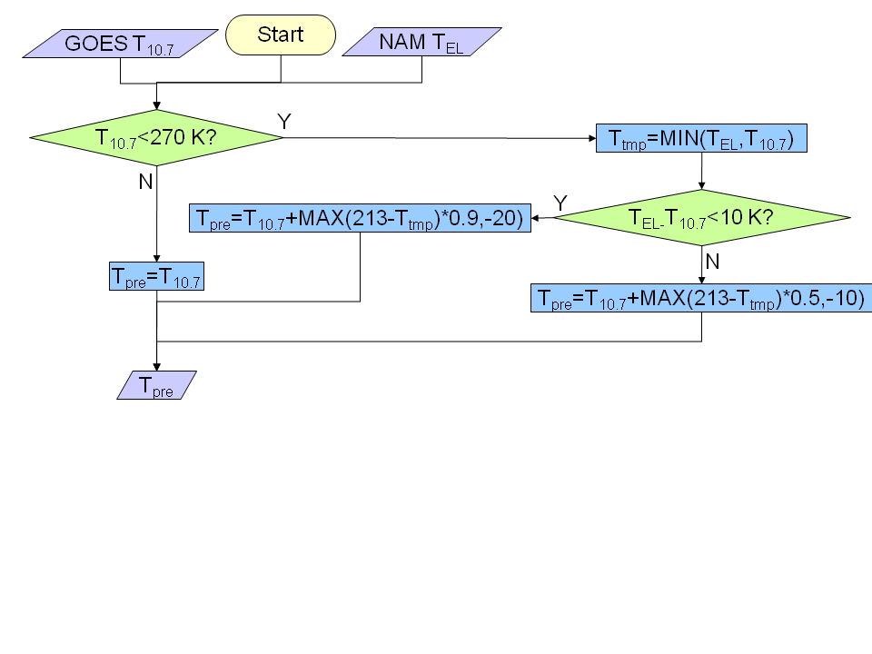
H-E Mathematical Description: IR Tb Adjustment (1/2)
Adjust pixel temperatures downward if the convective EL is warmer than 213 K.
This will increase rain rates (or even allow rain) for thermodynamic profiles that will not support very cold clouds (e.g., low tropopause).
Notes:
86
86
86
86

Slide 87
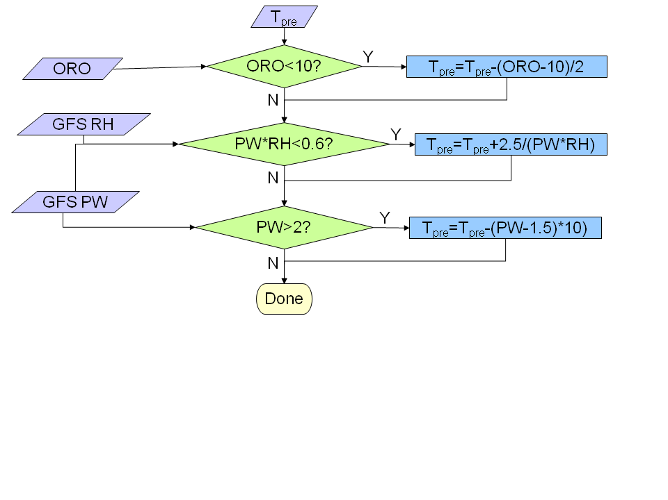
H-E Mathematical Description: IR Tb Adjustment (2/2)
Adjust the temperature downward for orographically-driven updrafts to enhance (or add) rainfall.
Adjust the temperature upward for dry environments.
Adjust the temperature downward for very moist environments.
Notes:
87
87
87
87

Slide 88
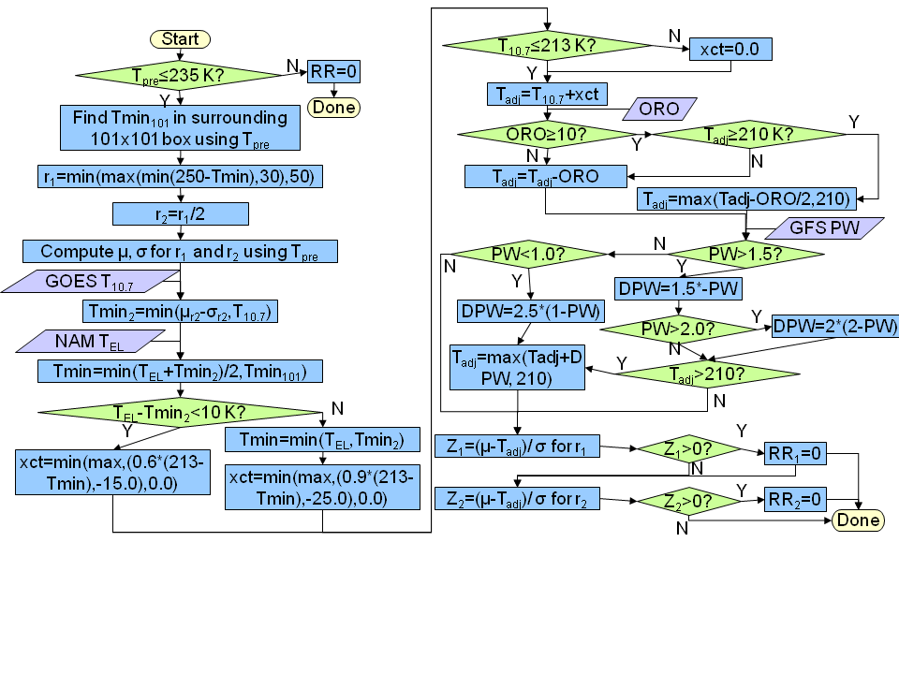
H-E Mathematical Description: Determine Raining Areas (Overview)
Determine the temperature relative to nearby cloud pixels; those cooler than the average of the nearby pixels are considered for assigning rain.
88
88
Notes:
88
88
88
88

Slide 89
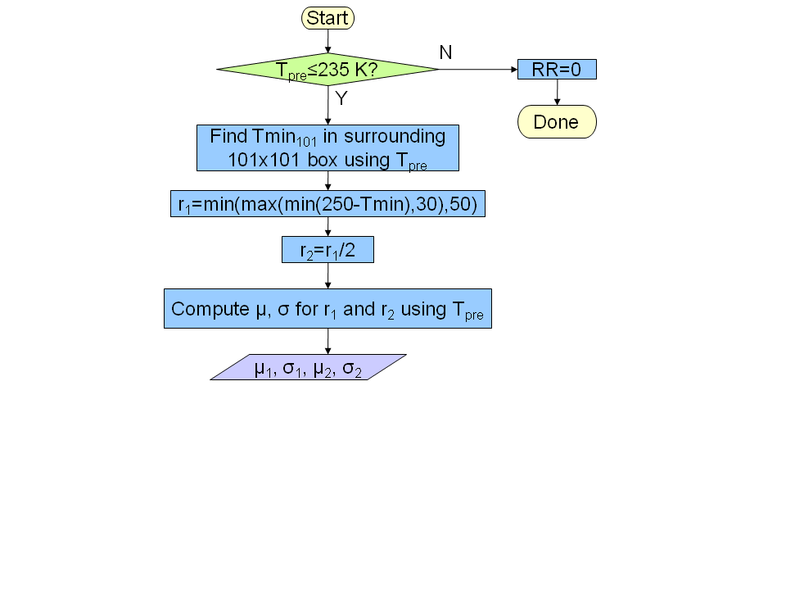
H-E Mathematical Description: Determine Raining Areas (1/6)
If the pixel is below 235 K, compute two search radii for surrounding cloudy pixels (the colder the pixel, the larger the radius).
Compute the mean and standard deviation temperature for both radii.
89
89
Notes:
89
89
89
89

Slide 90
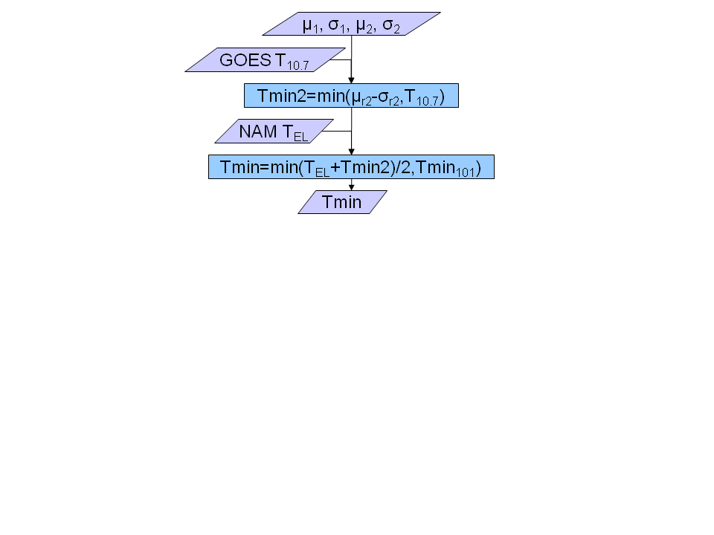
H-E Mathematical Description: Determine Raining Areas (2/6)
Determine the minimum temperature in the neighborhood and adjust for convective equilibrium level temperature.
90
90
Notes:
90
90
90
90

Slide 91
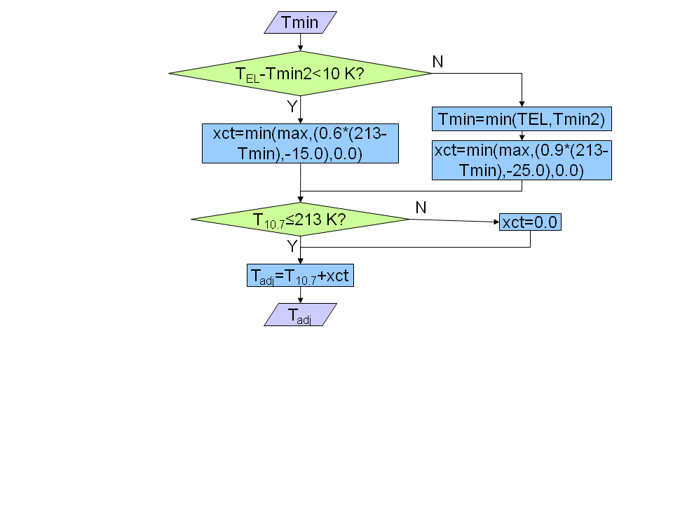
H-E Mathematical Description: Determine Raining Areas (3/6)
Perform additional equilibrium level adjustments to the temperature that will be used to compute the rainfall rate.
91
91
Notes:
91
91
91
91

Slide 92
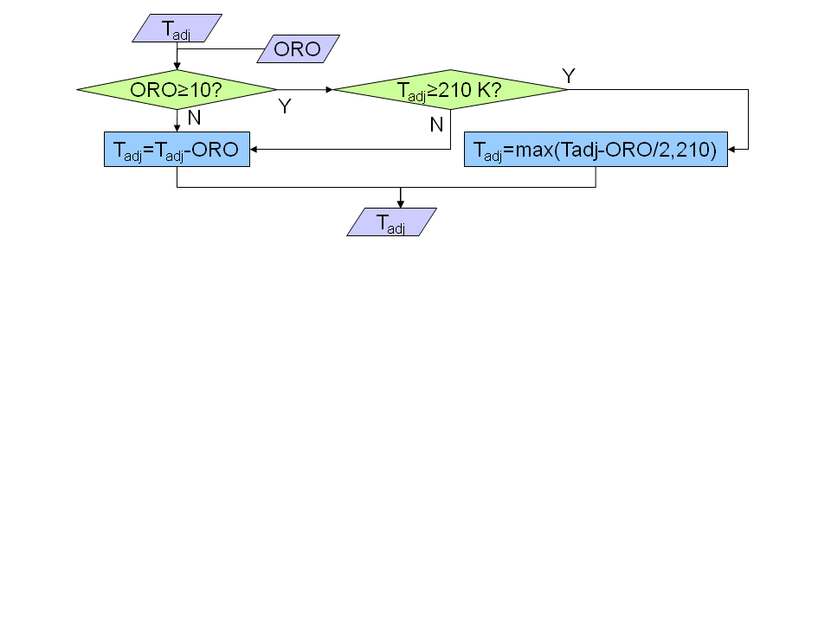
H-E Mathematical Description: Determine Raining Areas (4/6)
Apply the orographic adjustment to the temperature that will be used to compute the rainfall rate; reduce the adjustment for very cold pixels.
92
92
Notes:
92
92
92
92

Slide 93
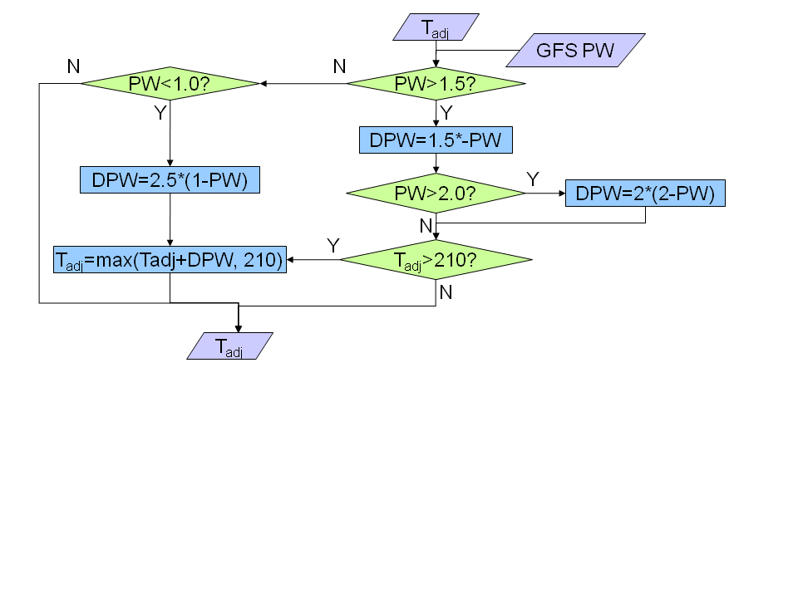
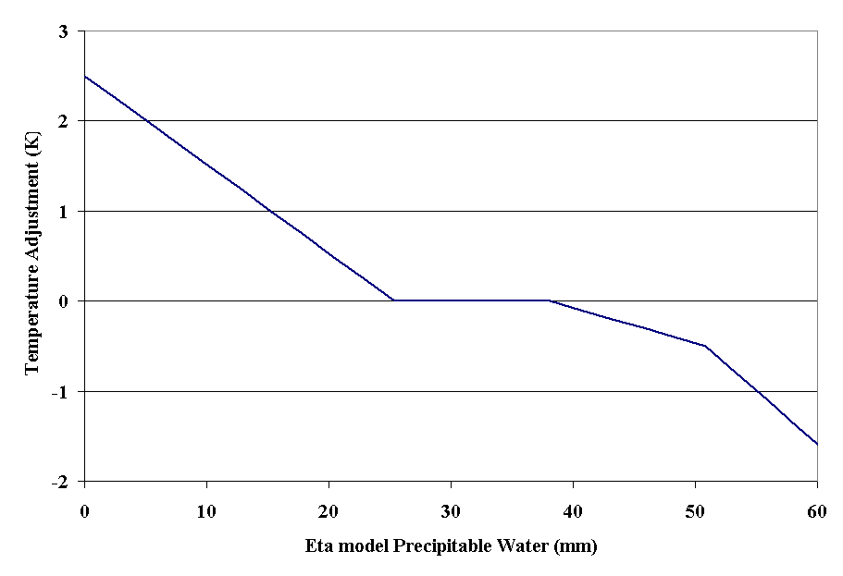
H-E Mathematical Description: Determine Raining Areas (5/6)
Adjust the temperature used for computing the rainfall rate for available moisture (adjust downward for moist environments).
93
93
Notes:
93
93
93
93

Slide 94
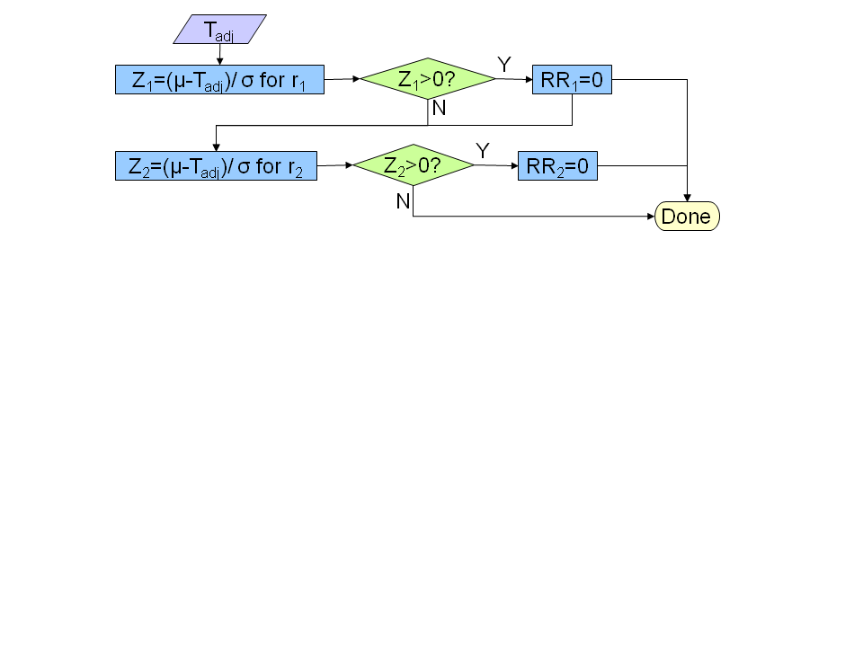
H-E Mathematical Description: Determine Raining Areas (6/6)
Compute the difference between the temperature and local mean (scaled to the standard deviation) for both search radii. Pixels with higher values of Z (colder relative to the local mean) will have higher rain rates.
94
94
Notes:
94
94
94
94

Slide 95
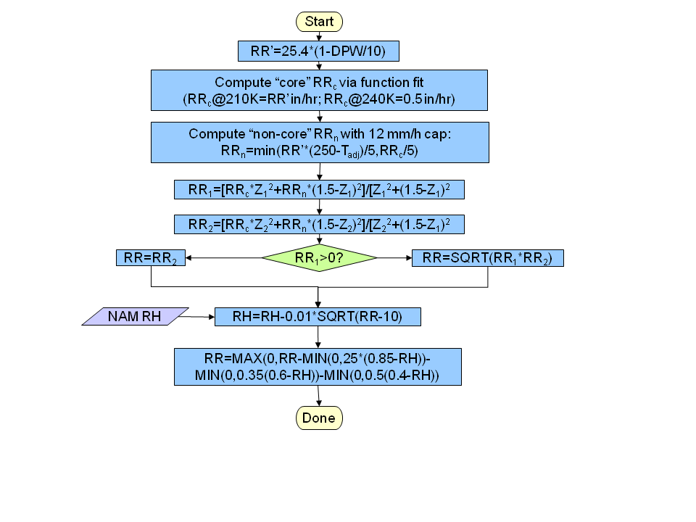
H-E Mathematical Description: Determine Rain Rate (Overview)
Compute the rainfall rate based on the values of Z at the two scales, then perform a final adjustment based on RH.
95
Notes:
95
95
95
95

Slide 96
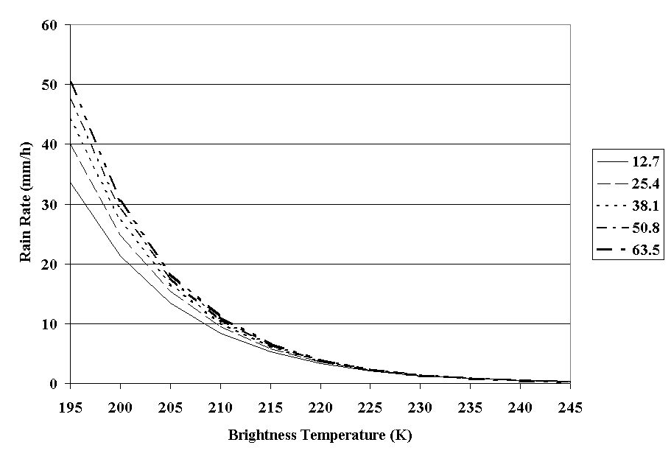
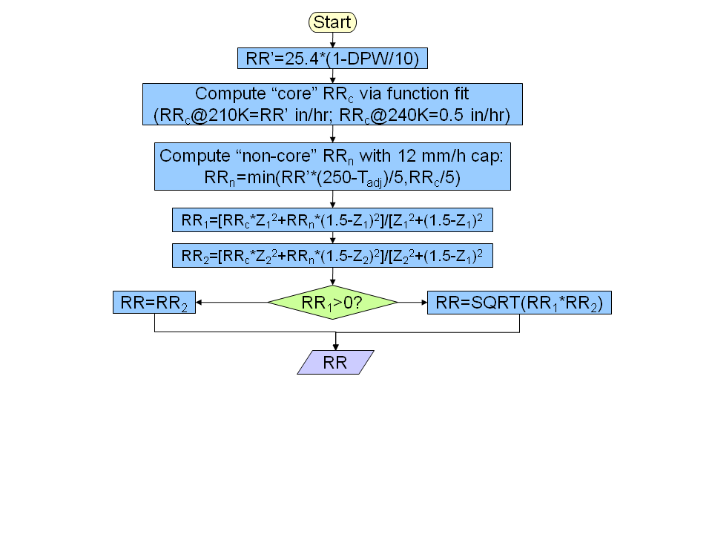
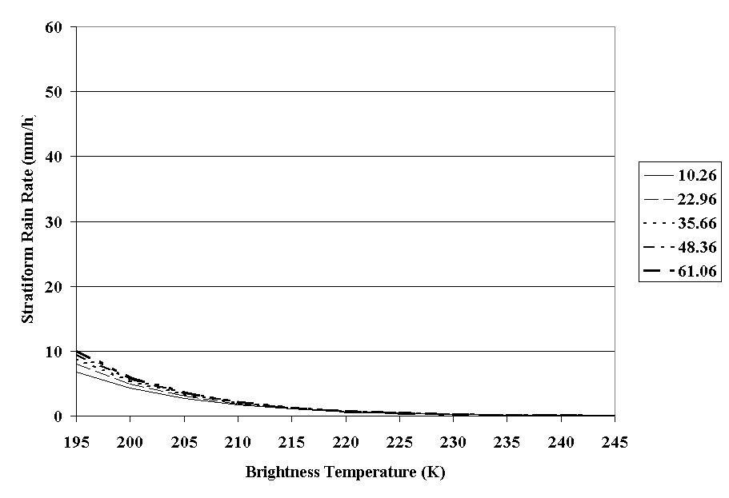
H-E Mathematical Description: Determine Rain Rate (1/2)
Compute separate “core” and “non-core” rainfall rates.
Compute the rainfall rate for each “neighbor” radius, weighting them “core” and “non-core” values according to Z.
If the far-radius rain rate is positive, use both in the final rain rate.
96
Notes:
96
96
96
96

Slide 97
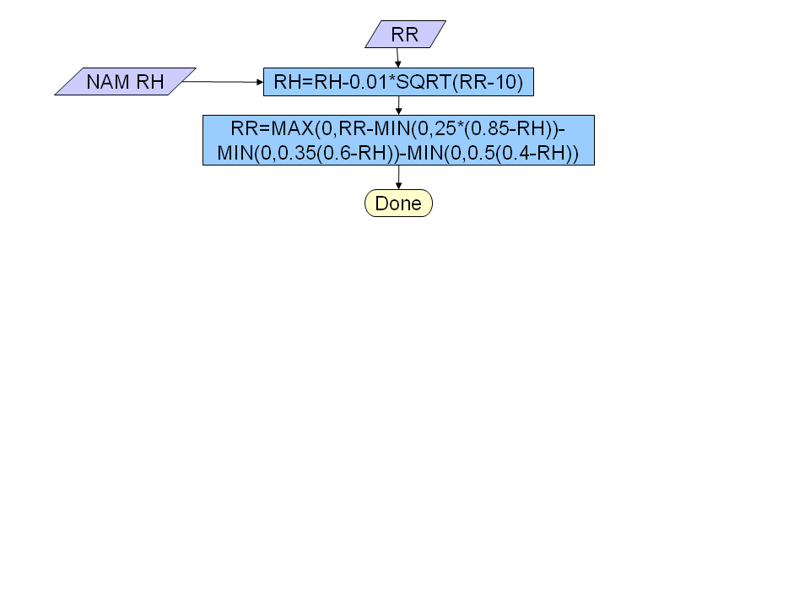
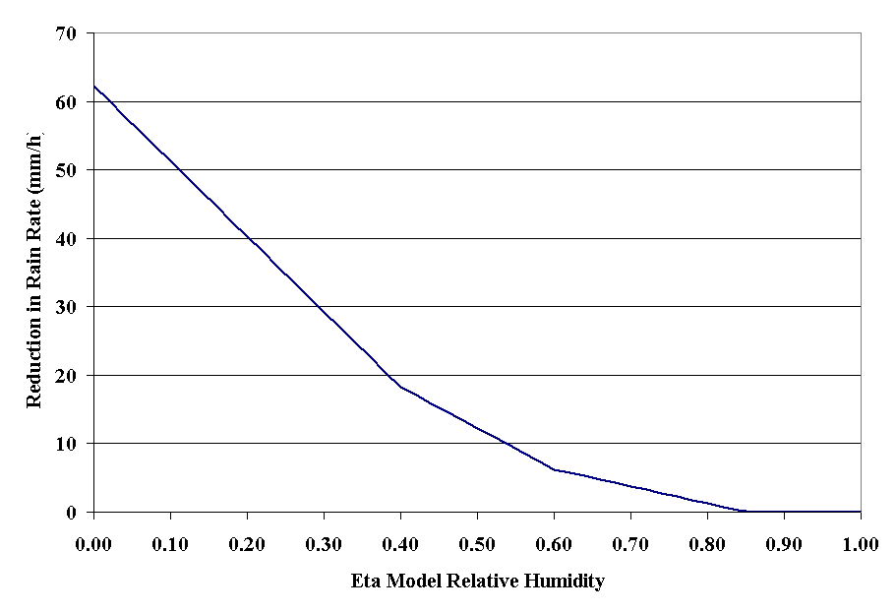
H-E Mathematical Description: Determine Rain Rate (2/2)
Adjust the rainfall rates downward for lower RH values using a function with 3 segments.
97
Notes:
97
97
97
97

Slide 98
Summary of H-E Rain Rate Retrieval
Create adjustment fields from GFS data
  PW, RH, convective EL, orographic correction
Determine if pixel is raining
  Adjust pixel temperature based on orography and moisture
  No rain if adjusted temperature > 235 K
  No rain if adjusted temperature > local average
Determine rain rates for raining pixels
  Compute “core” and “non-core” rain rates
  Compute rain rate based on proportion of “core” and “non-core” rain rates based on local Tb
98
98
98
98
Notes:
98
98
98
98

Slide 99
Practical Considerations (1)
Numerical computational considerations
  Each separate satellite can be processed in parallel processing if desired to reduce processing time
Programming and procedure considerations
  Sub-sectors could be processed, but margin needs to be included to avoid errors from processing partial clouds
99
99
99
99
Notes:
99
99
99
99

Slide 100
Practical Considerations (2)
Quality assessment and diagnostics
  Quality flags will be produced, with non-zero values for pixels whose inputs have values outside the acceptable range (values in ATBD)
  The following routine diagnostic procedures are recommended for evaluating performance:
    Examine image loops for artifacts or non-physical features
    Evaluate time series of bias statistics for anomalous behavior
100
100
100
Notes:
100
100
100

Slide 101
Practical Considerations (3)
Exception handling
  Quality control flags will be checked and inherited from the sensor input data for handling these exceptions
    Bad sensor input data (depending on what input QC available)
    Missing sensor input data
    Missing geolocation or viewing geometry information
  Missing (negative) values will be assigned to any pixel with quality issues or with any input values outside the acceptable range.
101
101
101
Notes:
101
101
101

Slide 102
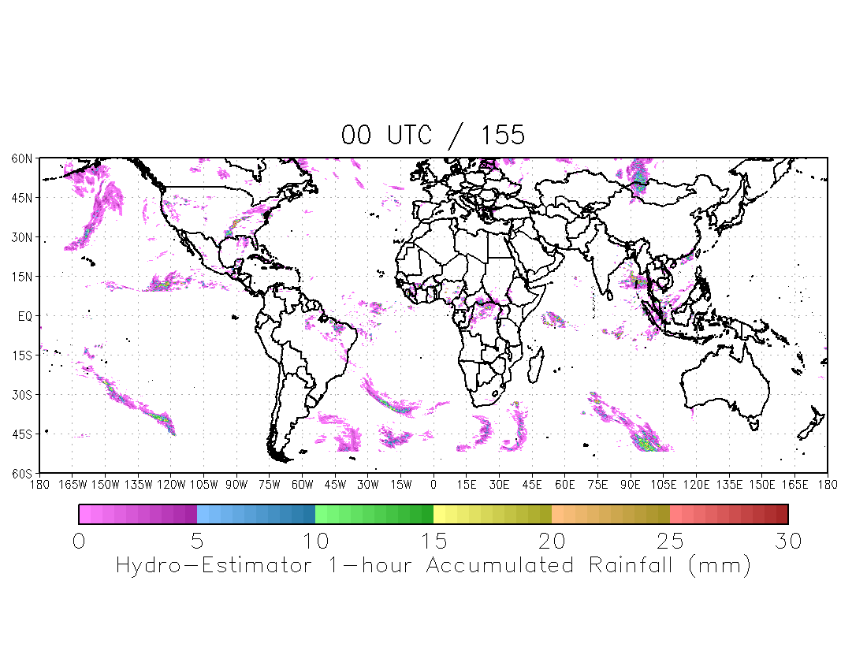
Example of Implementation from Current Processing at STAR
Retrieval of hourly rain accumulation from 00-23 UTC 4 June 2009
Inputs:
  IR window (11 µm) brightness temperatures from GOES-11 and -12, METEOSAT -7 and -9 and MTSAT-1R
  Numerical weather model adjustment parameters from GFS
TOA albedo
102
Notes:
102
102
102

Slide 103
Rainfall Rate Algorithm Verification
Compared retrieved instantaneous rainfall rates to Tropical Rainfall Measuring Mission (TRMM) spaceborne Precipitation Radar (PR) between 35ºS and 35ºN
103
Notes:
103

Slide 104
Rainfall Rate Algorithm
Performance Estimates
The rainfall rate algorithm will likely meet requirements:
  Validation versus TRMM Precipitation Radar (covering ±35° lat only ) for May through November 2007:
 | Specification |  | Evaluation vs. TRMM radar
 | Accuracy | Precision | Accuracy | Precision
Rain Rate | 6.0 mm/h | 9.0 mm/h | 5.8 mm/h | 9.0 mm/h
104
104
104
104
Notes:
104

Slide 105
Assumptions and Limitations
Assumptions:
  Cloud-top temperatures are related to surface rainfall rates
  The entire cloud of interest is contained within the image
  Striping is minimal (striping will adversely affect the computation of cloud characteristics)
  ABI data have been corrected for parallax
  Calibration over the CONUS is applicable to other parts of the world
Limitations:
  Better skill for convective rainfall than for stratiform rainfall (a standard limitation of satellite-based rain rate retrievals)
105
105
105
105
Notes:
105
105
105
105

Slide 106
Error Budget
Primary sources of error in rain rate are uncertainties in:
  Physical relationships between cloud-top temperature and rainfall rates
  Input IR brightness temperatures, due to errors in calibration and stability
  GFS model output fields for adjustments
Estimation of errors can be done by perturbing the different sources by known amounts and comparing the results to those from the un-perturbed values (at least in the first two cases)
106
106
106
Notes:
106
106
106

Slide 107
Product Quality Monitoring
Plan to develop an automated QC system to acquire, match and statistically compare satellite and (ground validation) radar estimates and alert if comparison statistics exceed pre-defined thresholds.
Input radiance and ancillary data QC:
  Gross checks (identify unphysical, out-of-bound, saturated values).
  Analysis of consistency with previous values.
  Check for simultaneous availability of all needed input.
Product QC:
  Quality control satellite product (check for unphysical/missing values, check consistency, etc.)
  Compare satellite product with radar observations.
  Flag data and notify when statistics exceed pre-determined levels.
107
Notes:
107
107

Slide 108
Summary
The Hydro-Estimator algorithm has been run in operations for the CONUS since 2002 and experimentally at STAR since 2005.
This project is transferring the global operational code at STAR to operations at OSPO.
The Hydro-Estimator uses IR brightness temperatures to identify regions of rainfall and retrieve rainfall rate, using GFS model fields to account for the effects of moisture availability, evaporation, orographic modulation, and thermodynamic profile effects.
108
108
108
108
Notes:
108
108
108
108

Slide 109
Outline
Introduction Zhao
Risks Wolf
Requirements Wolf
Operations Concept Zhao
Algorithm Theoretical Basis Kuligowski
Software Architecture &Interfaces Davenport
Quality Assurance Wolf
Risks and Actions Wolf
Summary and Conclusions Zhao

Slide 110
Software Architecture
and Interfaces
Presented by
Clay Davenport

Slide 111
Software Architecture
Purpose: Demonstrate that the algorithm process flow provides for an implementation that is consistent with the theoretical basis and meets requirements.

Slide 112
CDR Software Architecture
A preferred solution has been selected for GHE
  Will be documented in ATBD
The software system is an integrated collection of software elements, or code, that implements the preferred solution, producing well-defined output products from a well-defined set of input data.
The software architecture describes the structure of the system software elements and the external and internal data flows between software elements.

Slide 113
Software Architecture Levels
Context Level - 0
External Interfaces
System Level - 1
Flows Between Units
Unit Level - 2
Flows Within Units
Sub-Unit Level - 3
Flows Within Sub-Units

Slide 114
External Interfaces -- Definition
An external input is defined as a data source needed by the system that is produced or made available by a process external to the system
An external output is defined as a data sink that is produced by the system for an external user

Slide 115
External Interfaces - Criteria
Most input/output data files for the GHE algorithms will be obtained from/delivered to the NESDIS data servers in McIDAS format.
Static Files:
  Global terrain file (AREA file)
  Lookup tables for ground/satellite angles (ASCII)
Output Files
  Log files (ASCII)
  NetCDF4 version of output AREA files
The data passed to the units and sub-units will be stored in AREA files.

Slide 116
External Interface
Design at CDR
Global Hydro-Estimator System

Slide 117
Purpose
Purpose: Demonstrate that the GHE system provides an infrastructure that will enable the implementation of the GHE algorithms that meet requirements.

Slide 118
GHE System
Calculation of non-satellite inputs
Calculation of Rainfall Rate for each satellite/sector
Composite Rainfall Rate outputs

Slide 119
Data Flow and Interfaces
The following slides show the data flow and interfaces in the framework.

Slide 120
GHE System
Context Diagram
NCEP GFS Model Server
Algorithm Packages
Model
Data
Input Data
Products
Ancillary
Data
GHE System
File
Server
Lookup
Tables
Products
Satellite
Servers
Satellite
Imagery

Slide 121
GHE
System Level
Satellite Data
GOES-11
GOES-13
Meteosat-7
Meteosat-9
MTSAT-1R
NCEP GFS Model Data
Topo Maps
PW
RH
EQL
Orog
Rain Rates
Zenith Angle Adjustment
Parallax Adjustment
Joyce model

Slide 122
GHE
System Level
GOES-11 Rain Rates
GOES-13 Rain Rates
Meteo-9 Rain Rates
Meteo-7 Rain Rates
MTSAT-1R Rain Rates
Merger Algorithm
Global Rain Composite

Slide 123
GHE Inputs
McIDAS AREA files (IR imagery from five geosynchronous satellites)
McIDAS GRID files (data from GFS model)
Static Local Data
  Global Terrain Maps
  Lookup tables for viewing angle corrections

Slide 124
McIDAS AREA Files
The satellite imagery to be processed for rain rates will be received as McIDAS AREA files
  Five satellites provide global coverage
Satellite and sensor | Longitude | Band | Wavelength Range (μm) | Central Wavelength (μm) | Sub-satellite IGFOV (km)
GOES-11 Imager | 135°W | 4 | 10.20-11.20 | 10.7 | 4
GOES-13 Imager | 75°W | 4 | 10.20-11.20 | 10.8 | 4
METEOSAT-9 SEVIRI | 0°E | 9 | 10.28-11.28 | 10.8 | 3
METEOSAT-7 MVRI | 57.5°E | 3 | 10.5-12.5 | 11.5 | 5
MTSAT-1R Imager | 140°E | IR1 | 10.3-11.3 | 10.8 | 4

Slide 125
McIDAS AREA Files
In order to maximize coverage in both space and time, 13 different types of AREA files need to be pulled from the servers
  GOES-13: GEFDSK04I4 (3 hourly), GENHEM04I4 (30 min), GECONS04I4 (15 min), GESHEM04I4 (30 min)
  GOES-11: GWFDSK04I4 (3 hr), GWNEM04I4 (30 min), GWSHEM04I4 (30 min), GWPACU04I4(15 min)
  Meteosat-9: MSGLOB09I (15 min)
  Meteosat-7: INDOEXIR (30 min)
  MTSAT-1R: MTGLOB04I2 (60 min), MTNHEM04I2 (30 min), MTSHEM04I2 (6 hourly)

Slide 126
GFS Model Data
Model data updates every 6 hours
Always selects the most current model run containing data for selected time
Will continue to work through two missed model runs
Extracts vertical profiles of temperature and humidity at each grid point, total precipitable water, and 700 mb winds
Data is obtained in McIDAS GRID format, converted into AREA format to match satellite imagery

Slide 127
Static Local Data
Cloud-top temperatures are modified from a lookup table based on apparent temperature, zenith angle, latitude, and season (Joyce CPC model)
Global topographic files and land/sea masks, in AREA format, from SSEC and USGS

Slide 128
Product Precedence
Model-based adjustments (PW, RH, Orography, Stability) used by all satellites, are run as standalone jobs every hour
Each of the five satellite rainfall products is run as its own job (attempts every 15 minutes, skipped if no new satellite data)
Compositing programs create spatial mosaics and time summations; time summations run with each new rain image, global composite runs hourly

Slide 129
Product Precedence
Model Data
Precipitable water and relative humidity are directly taken from the NFS model, interpolated between model runs to an hourly product
Data transformed into a global AREA file
Each satellite run will extract the portion of the global field required

Slide 130
Product Precedence
Model Data
Orographic and equilibrium level files have to be derived from NFS model data
  Orographic data combined model winds with USGS digital terrain data
  Stability calculated by running model profiles through 1D model
Built separately for each satellite field, not a single global product
Have traditionally been made every six hours, without interpolation

Slide 131
Product Precedence
Satellite Runs
Each of the five satellites will run as a separate job to create a rainfall image within its field of view
Satellites are spaced 58-82°apart, with a 108°FOV providing overlapping coverage
Latitudinal coverage to 62°N and S
Each job is completely independent of the others and they can all run simultaneously
Latencies to data receipt range from 6-32 minutes after image time

Slide 132
Product Precedence
Satellite Runs
Zenith-angle adjustments to cloud-top temperature calculated from Bob Joyce’s model developed for CPC
Parallax adjustments to locations based on corrected temperatures and model profile data to determine cloud height
Rain calculation based primarily on corrected cloud-top temperatures and geometry, adjusted by other derived products

Slide 133
Product Precedence
Satellite Runs
GOES products are the most complicated
Need to follow a hierarchy to grab the best available from Full-disk data (available every 3 hours), to hemispheric data (every 30 minutes), to CONUS/PACUS products (15 minutes)
Can lose South American data for up to 3 hours during RSOs
Frequent gaps in southeast Pacific

Slide 134
Product Precedence
Satellite Runs
Meteosat-9 covers Europe and Africa every 15 minutes
Meteosat-7 covers Indian Ocean and central Asia every 30 minutes
MTSAT-1R covers Australia, east Asia, and the western Pacific
  Northern hemisphere every 30 minutes
  Southern hemisphere every 60 minutes

Slide 135
Product Precedence
Composites
Each satellite will have its own routine to create an hourly time summation of the observed precipitation
Summation routine runs by pixel, adapts for different sized images being summed
Time-weighted average – each pixel weighted by the portion of the hour it represents

Slide 136
Product Precedence
Composites
Mosaic program will run hourly to create a global composite rainfall image
Creates ‘seamless’ smooth averaging in the overlap regions using zenith angle weighting
Will also run for previous hours to catch later-arriving data

Slide 137
Output Files
Output files are in McIDAS AREA format and netCDF
Output files will be post-processed for final display and distribution to users and web
Composites over multiple time lengths
  N. America gets 0-1-3-6 hours, 1-7 days
  World gets 0, 1 hour, 1 day

Slide 138
Hardware
STAR
  Linux machine, 8 CPUs
  Capable of running all five satellite rain products simultaneously
OSPO
  Linux machine, 2 quad core CPUs (Development, Test, and Ops)
  Capable of running all five satellite rain products simultaneously

Slide 139
Software/Compilers
GHE System uses McIDAS
  version 2009 or higher required for Meteosat-9 imagery
  McIDAS 2010 uses freely available gcc and gfortran compilers (and older g77)
Shell scripts
  Control all processes and logging
CVS version control

Slide 140
External Interface
Design at CDR
Context Level

Slide 141
GHE Unit Level
Data Flows– Table
Input, Internal, and Output Data Flows at the Unit Level
Interface Item | Interface Type | Source | Description
Satellite IR | Input | NESDIS | GVAR calibrated and navigated brightness temperatures
Precipitable water | Input | NCEP | NWP forecasts of global PW
Relative humidity | Input | NCEP | NWP forecasts of low-level RH
Stability profile (EL) | Input | NCEP | Derived from NWP forecast temperature and moisture profiles
Model winds | Input | NCEP | NWP forecasts of 700mb winds
Global topographic map | Input | SSEC | Global 4km elevation map derived from the USGS GTOPO30
Viewing angle adjustments | Input | CPC | Lookup tables for adjusting cloud-top temperatures
Rain rates | Output |  | Global estimated precipitation

Slide 142
Design Overview and System Description

Slide 143
Design Overview Description
The design overview builds on the software architecture by providing a high level description of each system element that is defined in the software architecture.
The design overview describes the project system’s functionality and design characteristics at a high level that covers, for each system element:
  Its purpose
  External interfaces
  Decomposition into sub-elements
  Functional sequence
  Design Language
  Input and Output File Descriptions

Slide 144
STAR EPL Process –
Design Overview
Fully defines the structure and capabilities of the software product components.
  Software architecture details are finalized
  Software components are completely defined
  Interfaces to software components are fully characterized
  Connects the design to the allocated product-component requirements, architecture, and higher level designs

Slide 145
Metadata Design
STAR plans to work with OSPO to create a DSA with CLASS – still some uncertainty with both funding and time constraints
  Metadata design should respond to metadata requirements
  The metadata will be in the ISO standard
  STAR is familiar with the ISO standards through the NUCAPS project

Slide 146
GHE
Unit Description
Produce rain rates with associated quality flags.
Interfaces
  Satellite IR data, approx 10.7 um, from geosynchronous satellites
  Global Topographic maps
  Lookup tables for ground/satellite viewing angles
  Model data for moisture availability, stability, and winds

Slide 147
GHE Unit Description – PW
PW Process Start
Select current time
Search model data for time match
Convert from GRID to AREA
Exit

Slide 148
GHE Unit Description – RH
RH Process Start
Select current time
Search model data for time match
Convert from GRID to AREA
Exit

Slide 149
GHE
Unit Description – Orographic
Start Orographic routine
Create 1D, wind-following terrain array
Select global region topo map (input parameter)
Select 700 hPa U,V components from GFS
Calculate induced vertical lift
Remap winds to match topo region
Write to output AREA file
End orographic routine
Is it flat/at sea?
No
Yes

Slide 150
GHE
Unit Description – Equilibrium Level
Start EL routine
Run 1-D atmospheric model to calculate stability parameters at each grid location
Select global region (input parameter)
Select T,Z,RH, U,V components from GFS
Write equilibrium level temperature into GRID file
Rewrite GFS grid data into McIDAS MD format
End EL routine

Slide 151
GHE
Unit Description – Rain Rates
Start RR routine
Run rain rate calculation routine
Select satellite data from input region
Remap satellite data into standard regional Mercator
Write rain rates to output AREA file
Extract regional PW and RH AREAs from global AREA files
End RR routine
Select pre-made orographic and EL files for selected region

Slide 152
GHE
Unit Description – Spatial Mosaics
Start Mosaic routine
Remap each component to global map parameters
No
Current Goes-E RR?
Yes
Use blank RR
Use RR
Use blank RR
Current Goes-W RR?
Use RR
Use blank RR
Current Met-9 RR?
Use RR
Perform zenith angle weighted sum of all inputs
Use blank RR
Current Met-7 RR?
Use RR
Write to output AREA
Use blank RR
Current MTSAT RR?
Use RR
End Mosaic routine

Slide 153
GHE
Unit Description
Design Language – FORTRAN 77/90
Assumptions apply to the unit design:
  NWP data of comparable or superior quality to the current 6 hourly GFS forecasts are available.
  The sensor input data, IR brightness temperatures, meets the requirement
Limitations apply to the unit design:
  The algorithm does minimal error checks for the input files.

Slide 154
Outline
Introduction Zhao
Risks Wolf
Requirements Wolf
Operations Concept Zhao
Algorithm Theoretical Basis Kuligowski
Software Architecture &Interfaces Davenport
Quality Assurance Wolf
Risks and Actions Wolf
Summary and Conclusions Zhao

Slide 155
Quality Assurance
Presented by
Walter Wolf

Slide 156
QA Overview (1)
CMMI = Capability Maturity Model Integration
STAR is using the Capability Maturity Model Integrated (CMMI) for improvement of the process and practices for the transfer of research to operations.
STAR Enterprise Life Cycle (EPL) merge the CMMI and SPSRB standards.
Multiple PSDI projects are being tranistioned to operations using the EPL process
GOES-R AWG algorithm development also followed the same process.

Slide 157
QA Overview (2)
Product & Process Quality Assurance is one of the CMMI Key Process Areas (KPA).
QA Purpose:
  Problem Prevention
  Early Error Detection
  Risk Identification and Mitigation

Slide 158
Quality Assurance
Quality assurance consists of PROCESS QA and PRODUCT QA
PROCESS QA is concerned with assuring that the STAR EPL process standards are met during the planning, development, operations, and distribution phases of the project.
  Process QA is achieved through the standard reviews of the STAR EPL process. Each review checklist and entry/exit criteria are designed to ensure that the relevant process standards are met by the implementation of standard practices during the steps leading up to the review.
PRODUCT QA is concerned with assuring that the work products created during the project’s lifecycle meet their requirements
  Product QA is achieved by verification of the project’s work products and validation of the products, operator needs, and user needs

Slide 159
QA Activities
Configuration Management
Project Monitoring
Validation and Verification
Documentation
Standard
Testing
Tools
Collaboration and Communication
Website

Slide 160
Configuration Management (CM)
CM Tool (IBM Rational ClearCase, Version 7.0)
CM personals have been identified.
CM training has been conducted
  Administrator training completed (Xingpin Liu)
  IBM on site training for developers is being scheduled
Detailed CM Plan has been developed

Slide 161
CM Stakeholders
Xingpin Liu (AIT)
  CM Lead
Yunhui Zhao (AIT)
  CM Administrator
Mark Romer, Brian Keffer (STAR IT)
  CM installation
GHE Team Developers
  CM Users

Slide 162
Project
Monitoring and Control
Provides management with objective feedback regarding process compliance to approved plans, procedures, standards, and analyses.
Identify and track the issues and risks throughout the lifecycle
Document these activities in the Project Monthly Reports

Slide 163
Validation of
GHE Needs
The GHE software will be delivered to the OSPO team.
The OSPO team will then integrate and operate the GHE software within the development environment.
The GHE software will then be run within the test environment before being transitioned to operations.

Slide 164
Validation of
GHE Needs
Functionality Within the Development Environment
  Able to compile and run on the hardware
    The development machine is the same hardware as the test machine so a successful compile and run should demonstrate this functionality.
  Able to handle external interfaces
    Test files will be used to show that the software units can handle the external interfaces.
  The standard output format for near real time products is netCDF4 and McIDAS.
    A simple demonstration test will show that the output files can be read by netCDF4 and McIDAS readers therefore showing that they are valid output files.
  STAR code checkers will be used to ensure that code meets the agreed-upon coding standards.

Slide 165
Validation of
User Needs
The GHE External User’s Manual will be part of the documentation suite. Validation will consist of allowing reviewers to inspect the document to ensure that all required sections are present.
The “Users” are the users of the GHE data products
The user needs consist of the following project documentation and tools:
  GHE External User’s Manual

Slide 166
Products Verification and Validation (V&V)
Product V&V activities are performed and carried out over the life-time of the project.
  Pre-Delivery:
    Performed quality check of the codes.
    Verify the output running on the test datasets.
    Verify the output from the GHE system.
    Use tools for validation of the products
  Post-Delivery:
    Verify the output from the GHE system.
    Use tools for validation of the products

Slide 167
Verification Methods
Analysis consists of activities such as the generation of statistics to examine the distribution and errors and the comparison of results with reference data.
Inspection is simply verifying that required element is present or that the expected output was obtained.
Demonstration is meant to illustrate the functionality of something such as a software unit.

Slide 168
Verification:
Data Product

Slide 169
Verification:
Software and Tool
Item
Method

Slide 170
Documentation
SPSRB Documentation will be produced
Documentation will be delivered along with the release of software.

Slide 171
Verification―
Documentation
Item
Method

Slide 172
Algorithm Testing
Plans for Testing
Unit Testing
Integration Testing
Test Review/Report

Slide 173
Coding Standards
Coding standard guidelines and quick references are available.
Provide a common list of abbreviations.
Adhere to the standards throughout the development life cycle.
Have checklists available for developers to keep track of the delivery status of the code.

Slide 174
Tools
Code Generators
Fortran 77 to Fortran 90 Converters
Revision Control
  Clear Case, Clear Quest, CVS

Slide 175
Collaboration and
Communication
Maintain communication with all the stakeholders, such as the OSPO, NCEP, JCSDA, CLASS and the GHE Team.
Keep all the project artifacts/assets available to the stakeholders.

Slide 176
QA Summary
QA activities are being performed throughout the GHE software development life cycle.
Code development and documentation follow the guidelines/standards of STAR EPL and SPSRB.
Tools and procedures for QA are under development.
The QA process will assure faster and more efficient research to operation transitions.

Slide 177
CDR Risks and
Actions For GHE
CDR Risk 3: Schedule delays
Risk Assessment: Low
Impact: Schedule delays will cause an increased in cost to the project
Likelihood: Low
Mitigation:
  Review all the project tasks on a monthly basis. If tasks start to slip Integration Team will work more closely with the GHE team to help it catch up.
Status: Open

Slide 178
Outline
Introduction Zhao
Risks Wolf
Requirements Wolf
Operations Concept Zhao
Algorithm Theoretical Basis Kuligowski
Software Architecture &Interfaces Davenport
Quality Assurance Wolf
Risks and Actions Wolf
Summary and Conclusions Zhao

Slide 179
Risks and Actions Summary
Presented by
Walter Wolf

Slide 180
Open Pre-CDR Risks and
Actions For GHE
Pre-CDR Risk 2: Possible loss of MeteoSAT
  Mitigation:
    Work with NESDIS management to ensure that MeteoSAT data is readily available

Slide 181
Open Pre-CDR Risks and
Actions For GHE
Pre-CDR Risk 3: Compressed schedule due to funding needing to be spent by 09/30/11
  Mitigation:
    Add more staff on the STAR and OSPO side to complete the transition tasks before 09/30/11
Pre-CDR Risk 4: No current funding past 09/30/11
  Mitigation:
    Work with NWS to extend leftover funding into FY12

Slide 182
GHE CDR
Risks and Actions
Risk 1: Lack of enough funding for product quality monitoring of the GHE algorithm -- not fully scoped in the current project plan
  Mitigation:
    Work with Zhaohui Cheng & Walter Wolf to leverage the Product Monitoring PSDI
Risk 2: Lack of time to work through the required archive procedures; No funding is provided for archive from NWS
  Mitigation:
    Work with NCDC/CLASS to identify the archive funding requirements
    Work with OSD and/or NWS to see if there is any funding available for archive.

Slide 183
GHE CDR
Risks and Actions
CDR Risk 3: Schedule delays
  Mitigation:
    Review all the project tasks on a monthly basis. If tasks start to slip Integration Team will work more closely with the GHE team to help it catch up

Slide 184
Review Items Summary
4 Pre-CDR risks have been reported in the CDR, 3 of which are still open.
3 risks and actions from the CDR were reported earlier in this CDR and all 3 are still open.

Slide 185
Outline
Introduction Zhao
Risks Wolf
Requirements Wolf
Operations Concept Zhao
Algorithm Theoretical Basis Kuligowski
Software Architecture &Interfaces Davenport
Quality Assurance Wolf
Risks and Actions Wolf
Summary and Conclusions Zhao

Slide 186
Summary and Conclusions
Presented by
Limin Zhao

Slide 187
Review Objectives
Have Been Addressed
Pre-CDR Report has been reviewed
Operations concept has been reviewed
Requirements have been reviewed
Algorithm theoretical basis has been reviewed
Software system architecture and interfaces have been reviewed
Plans for quality assurance have been reviewed
Open Risks and Actions have been reviewed

Slide 188
Next Steps
Code Development Phase
  Code development
  Test data generation
  Unit tests
  Prepare documentation
  Software Review (Oct 31, 2011)

Slide 189
Open Discussion
The review is now open for free discussion

Slide 190
Appendix

