Slide 1
SPSRB Decision Brief on Retiring “Product Name”
Date
Presenter:
Guidance can be found on the note pages. Delete this banner when submitting your proposed briefing to SPSRB Manager
Notes:
Add the “title” of the product or service to the cover slide.
When this briefing has been properly coordinated with the Integrated Product Team and your office branch/division chief, submit the briefing to the SPSRB Manager (i.e., Richard Schreitz). Briefings are due 12 priors to the SPSRB which is normally the 3rd Wednesday of the month.

Slide 2
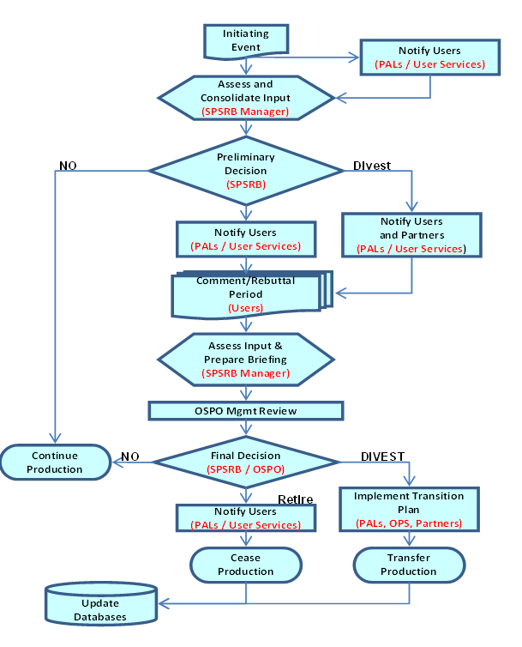
Retirement Process Diagram
We are here
Notes:
The purpose of the Product Retirement or Divestiture phase (above Figure) is to identify products that are no longer needed and can be terminated or the responsibility for production can be divested or transferred to another organization. This process provides for the opportunity to obtain user feedback and for the evaluation of that input by several levels of management and key decision-making points leading either to the cessation or transfer of the production of that product or service
Move the “we are here arrow” to the appropriate step. For example, if you are doing the final decision brief to the SPSRB, you move it down to this step.

Slide 3
Integrated Product Team (IPT)
IPT Lead:
NESDIS Team:
STAR:
OSPO:
OSGS:
NCEI:
Others:
User Team
Lead:
Others:
Oversight Panel (OP) lead:
Other OPs involved:
Notes:
The IPT Lead is the person responsible for leading the retirement/divestiture efforts.
List members and organizations of the IPT that will participate in the retirement/divestiture efforts. If applicable (i.e., product is archived) this includes a data center person that assist in assessing the impacts on the archive users.
In the NESDIS others bullet, you may want to identify the contractors working the retirement/divestiture efforts
Add appropriate Oversight Panel information. List of OPs can be found at http://projects.osd.noaa.gov/spsrb/pops.htm
Give the IPT members an opportunity to review, comment and concur on this briefing before going to the SPSRB.

Slide 4
Reasons for Retirement/Divestiture
State the reason this product is being retired/divested (i.e., system driven, user driven, fiscally driven, replaced by new product)
Benefits and impacts from retiring/divesting the product
Notes:
System-driven events include the failure, upgrade, or replacement of a satellite platform, satellite instrument or IT system
User-driven events result from evolving or new user requirements
Fiscally-driven events are those that necessitate ceasing or transferring production based on limited resources or changing organizational missions
List the benefits and impacts from the retirement

Slide 5
Current Operational Capabilities
 | Replacement Product | Proposed Retired Product
Satellite Source (s)
Product Name
Accuracy
Latency
Timeliness
Coverage
Resolution
Other attributes
Notes:
If propose a new product to replace the existing product, please fill in both columns. Otherwise, put N/A in the first column.
Briefly summarize our current capabilities to be addressed by this project. Definitions for these attributes are:
Accuracy
The systematic error, as specified by the difference between a measured or derived parameter and its true value in the absence of random errors. It can be thought of as the loseness of truth and is measured by the bias or systematic error of the observation, that is, the difference between the short-term average measured values of a variable and the truth. The short-term average is the average of a sufficient number of successive measurements of the parameter under identical conditions such that the random error is negligible relative to the systematic error.
Latency
Averaged elapsed time from data observation to delivery of the data to the user.
Timeliness
Latest time after observation by which an element can be delivered and still be useful to the customer.
Coverage
Coastal : Refers to the aerial extent consistent with the U.S. Exclusive Economic Zones (EEZ) that extends 370 km from shore. Coastal waters defined as far inland as the top of the watershed.
Conus: Contiguous U.S. rectangle, 3000 km N/S by approx 5000 km E/W.
Global: Self-explanatory.
Hemi: For N, S ,E ,W Hemispheres
Meso: For Mesoscale - Regional or local area, provide size and center point
Offshore: Farther than 100 km offshore.
Other: Enter as you see applicable (e.g. Coral Reefs, etc)
Vertical Resolution
The smallest height increment of the data. Spatial granularity in the vertical with which information and data are provided. For example: distance between adjacent vertical grid points in a radiosonde observation.
Horizontal Resolution
The dimension of the smallest object, horizontal area represented by the parametric value. Spatial granularity with which the information is required.

Slide 6
Product Details
 |  |  |  | # of Products
Product Name | Environmental Observational Parameters | Satellites | Sensors | T # | D # | Tailoring Options or Comments
T=Terminate D=Divest
Notes:
Fill in Proposed Retired Product Name.
Fill in Proposed Environmental Observational Parameters (EOPs) of the Product that will be retired. Occasionally a product has multiple (EOPs). List all EOPs on this slide.
Fill in the satellites that are used in the product
Fill in the sensors that are used in the product
List the type and number of products that will be retired. Use these definitions for guidance:
** Terminate = Cessation of a product operation
** Divest = Transfer of capabilities to other organization
Fill in tailoring options or comments. These are comments that help explain the number of products within a product retirement. Tailoring options might be format options (e.g., BUFR and HDF), coverage options (global, orbital, x regional sectors, etc.), gridding options, resolution options, etc.

Slide 7
Retirement Tracking Milestones
Product Name: xxxx
MMM YY: Initiation of the retirement request (fill in the request form)
MMM YY: PAL notify users
MMM YY: SPSRB manager assess and consolidate input
MMM YY: SPSRB board preliminary decision
SPSRB briefing for preliminary decision
MMM YY: SPSRB manger notify the PAL
MMM YY: PAL notify primary users to assess the impact
MMM YY: User Services send out notification to ESPCNotification for secondary user
MMM YY : Announcement of intent to retire the product post on SPSRB
MMM YY: Comment and Rebuttal period for impact assessment from users
MMM YY: SPSRB manager assess input and prepare briefing
MMM YY: OSPO management review
MMM YY: SPSRB board final decision
MMM YY: SPSRB manager notify the PAL of the final decision
MMM YY : Implementation of the retirement (PAL)
PAL notify primary user for the retirement of the products
PAL submit CCR to retire the product and make sure the completion of the CCR
User Services send out notification to ESPCNotification for secondary user
SPSRB manager ensure the announcement posted on OSPO web
User Service ensure OSPO web page remove the retire product
MMM YY: Retire product (30 days from the SPSRB decision date)
Notes:
List Retirement Milestones. These milestones are reflected on the overall flow chart that follows.

Slide 8
Data Flow Diagram
Notes:
Put the check mark on the completed steps

Slide 9
Recommendation
Product Name
Terminate? –
Divest? –
Notes:
Note: This slide will be used for Final Decision Briefing only. Don’t include this in the Preliminary Decision Briefing
Terminate = Cessation of a product operation
Divest = Transfer of capabilities to other organization

Slide 10
SPSRB Decision
STAR senior representative input
OSPO senior representative input
OSGS senior representative input
Consensus decision reached?
Yes: summarize decision
No: summarize direction
Notes:
IPT should not fill out this slide. It’s a place holder for the SPSRB decision.

